Slide 2
INDEX
NEW SERVICE: DEFINITION
NEW GUEST JOURNEY
ONLINE PROCESS
FRONT OFFICE DAILY WORKFLOW IMPACTS
TMS GUIDES
ANNEX

Slide 3
ONLINE CHECK IN & CHOOSE YOUR ROOM
New service:
ONLINE CHECK-IN (OCI)
(includes CHOOSE YOUR ROOM functionality)

Slide 4
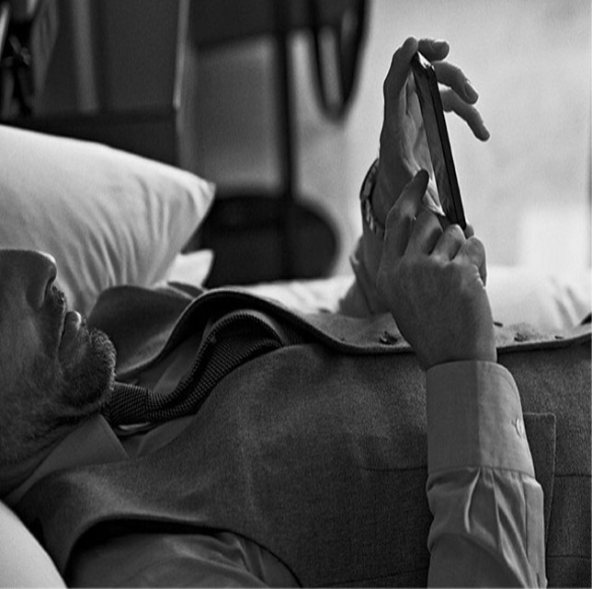
NEW SERVICE
ONLINE CHECK IN & CHOOSE YOUR ROOM
Online Check-in is a new NH online service that will allow our guests to anticipate most part of the check-in process by entering their personal data for the registration form, guaranteeing their payment method and even choosing their room directly from the hotel floorplan!
By using this new function guests will be able to manage their time as they prefer.

Slide 5
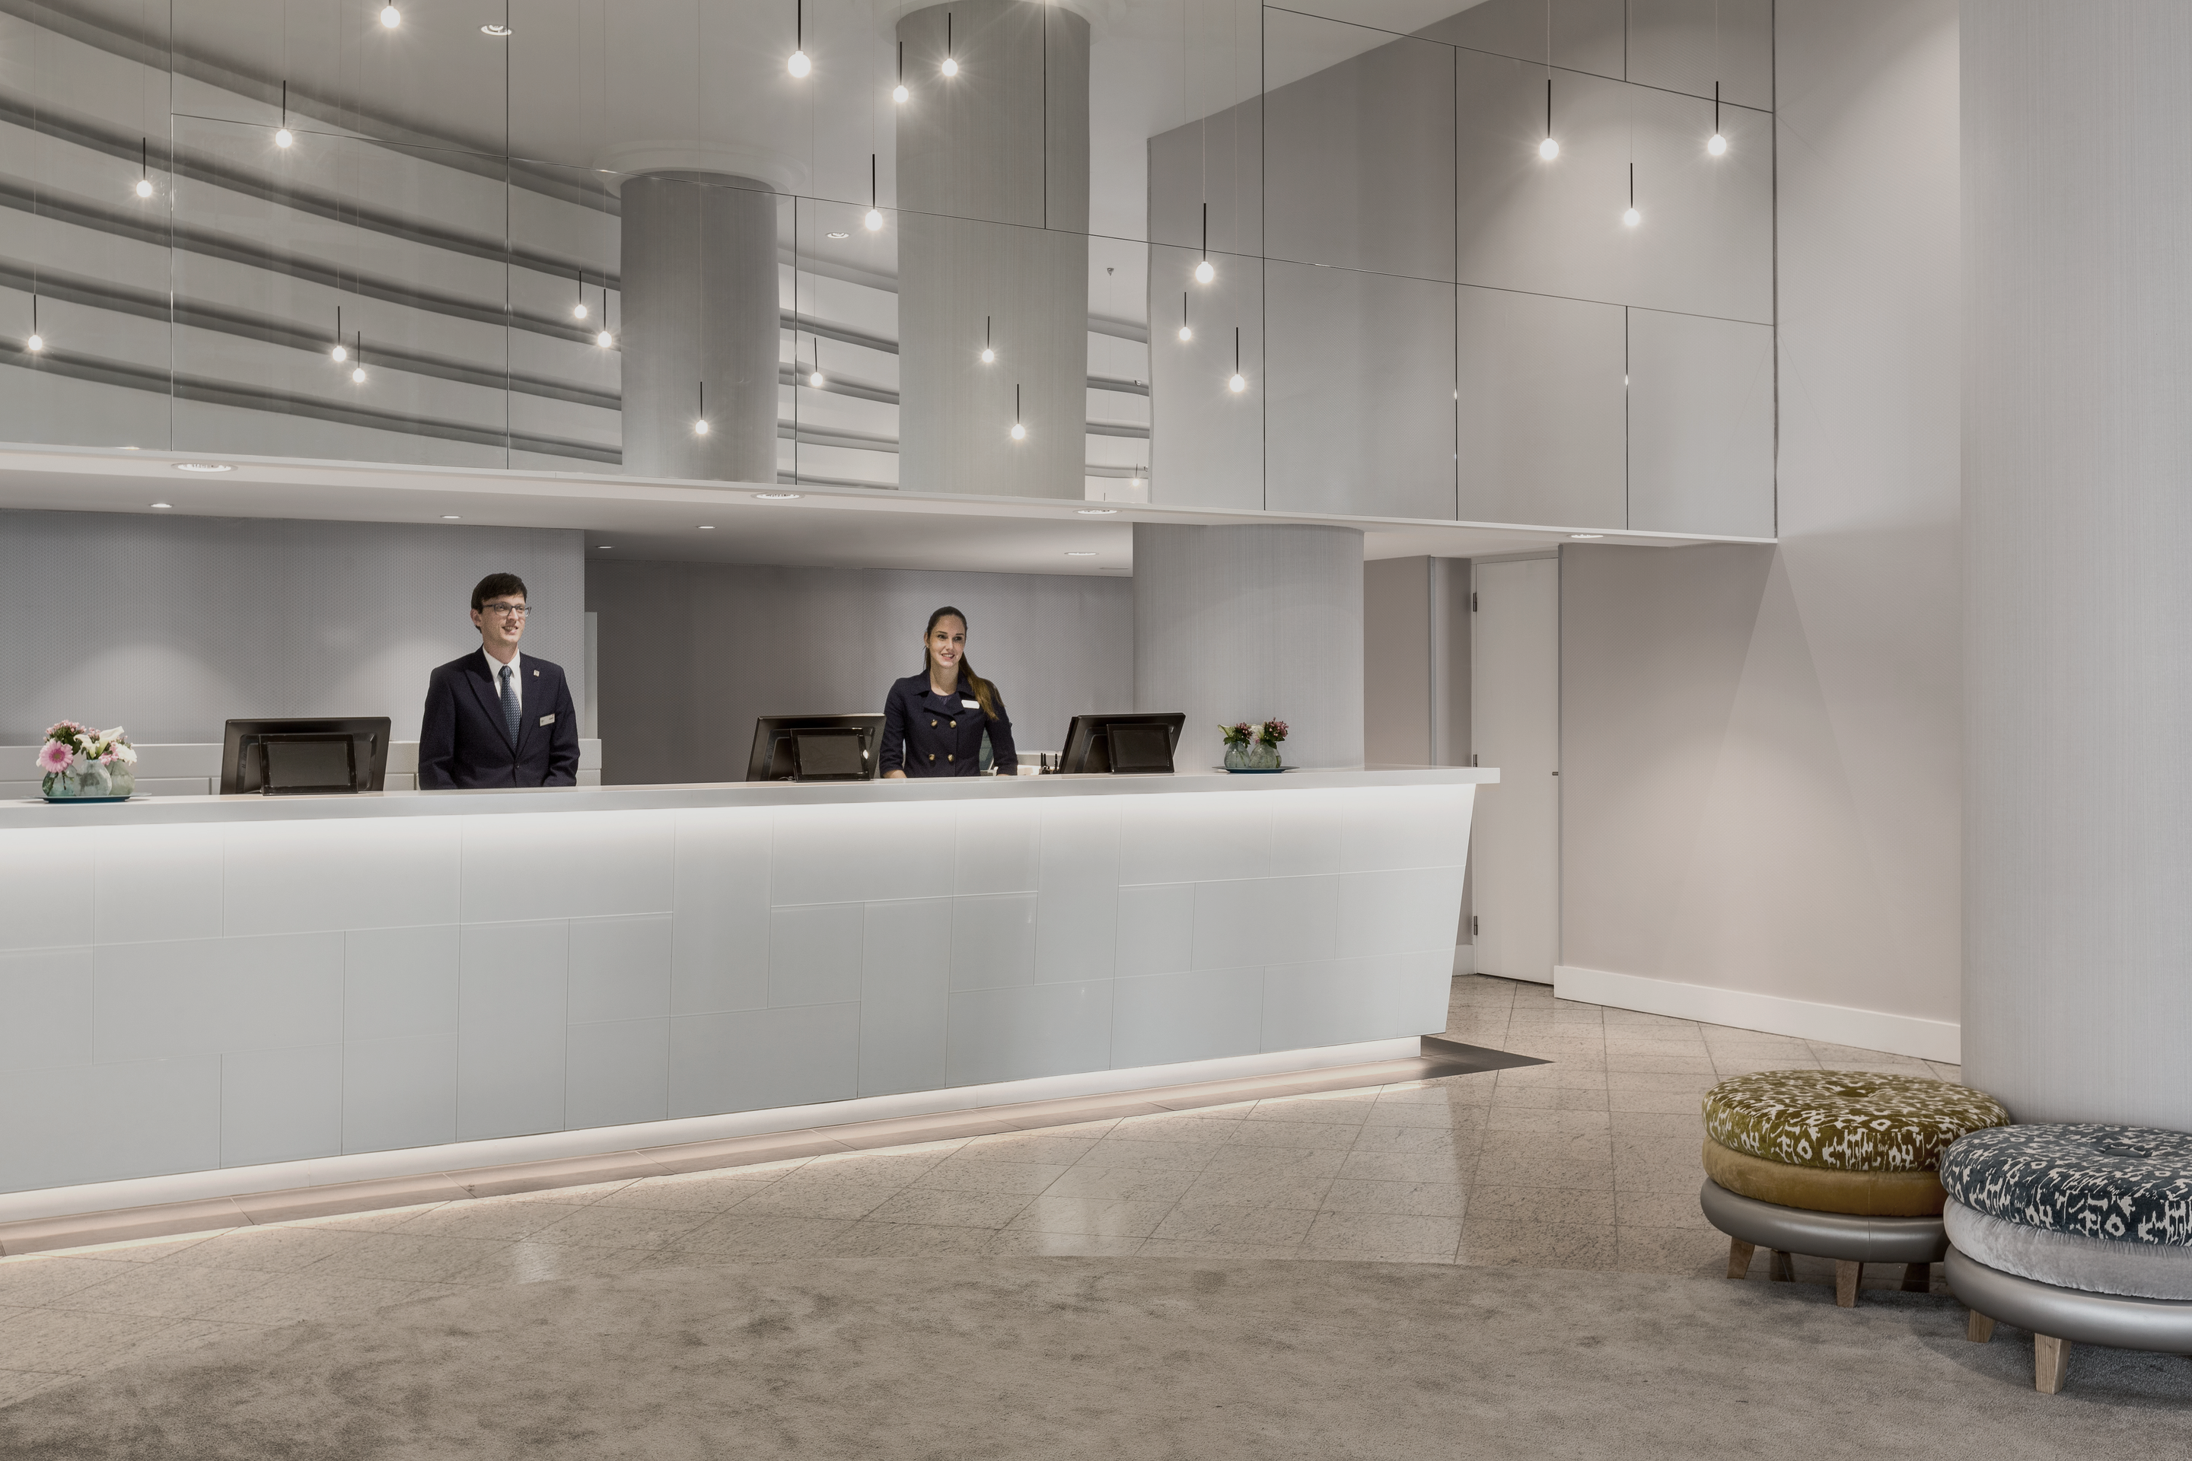
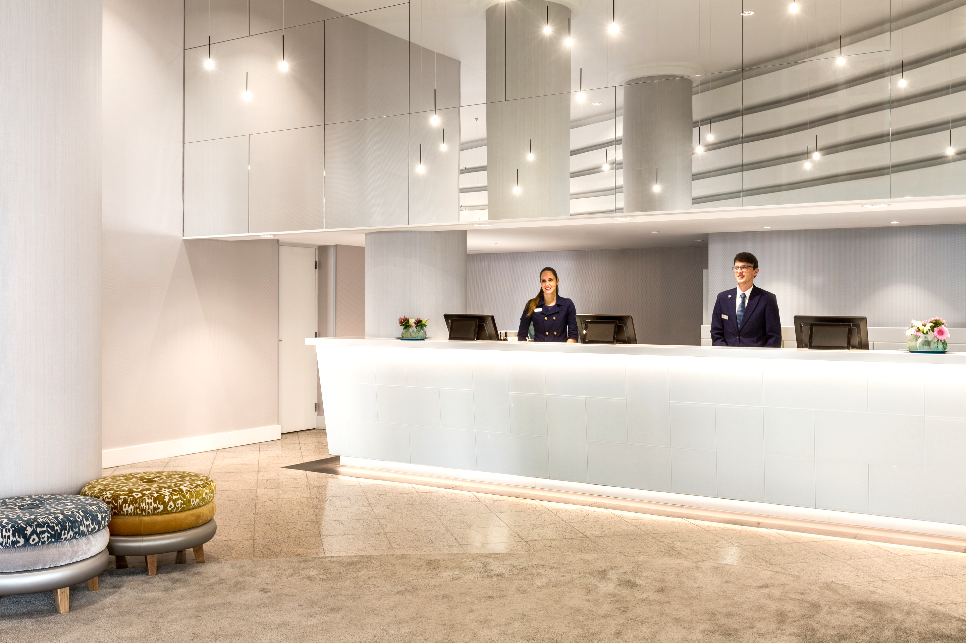



BENEFITS
ONLINE CHECK IN & CHOOSE YOUR ROOM
We can focus on the things that matter most
I need a credit card as a guarantee please
Is your first time in the city?
Do you need any information about events, shows…?
May I have your ID please?
Can you repeat your address please?
I’d like to invite you to join our Loyalty programme NH Hotel Group Rewards
I just need you to sign here..
Will you have dinner with us?
Based on procedures
Based on customer experience

Slide 6




SERVICE – BASIC INFORMATION
ONLINE CHECK IN & CHOOSE YOUR ROOM
How can the guest access to OCI?
From which platform?
When?
What kind of reservations?
DIRECT CHANNEL
Web
+
CRO &
hotel
(only direct reservations)
Guest can access through:
Link included in Pre-arrival email
NH App (My reservations)
NH website (using reservation ID)
NH APP
&
WEB
(MOBILE & DESKTOP)
The service will be available for guests use from 10 a.m. two days before arrival until 12:00 p.m. of the day of check-in.
The OCI will be available
ONLY
for individual reservations
with
1 or more guests
Only 1 of the guests can choose the room.
It is not mandatory that all the guests hosted in the room complete the OCI process.
Guest not registered online will have to complete the process at the front desk
INDIRECT CHANNEL
OTAS
GDS
Travel agencies
Guest can access ONLY through NH website using his reservation ID
(e-servicing)
MINORS (under 18)
CANNOT Access to OCI.
They will always have to go to Front desk.
M
T
W
T
F
S
S
10 am

Slide 7
SERVICE – BASIC INFORMATION FOR PHASE I
ONLINE CHECK IN & CHOOSE YOUR ROOM
How can the guest access to OCI?
From which platform?
When?
What kind of reservations?
DIRECT CHANNEL
Web
+
CRO &
hotel
(only direct reservations)
Guest can access through:
Link included in Pre-arrival email
NH App (My reservations)
NH website (using reservation ID)
NH APP
&
WEB
(MOBILE & DESKTOP)
The service will be available for guests use from 10 a.m. two days before arrival until 12:00 p.m. of the day of check-in.
The OCI will be available
ONLY
for individual reservations
with
1 or more guests
Only 1 of the guests can choose the room.
It is not mandatory that all the guests hosted in the room complete the OCI process.
Guest not registered online will have to complete the process at the front desk
MINORS (under 18)
CANNOT Access to OCI.
They will always have to go to Front desk.
M
T
W
T
F
S
S
10 am

Slide 8
ONLINE CHECK IN & CHOOSE YOUR ROOM
NEW GUEST JOURNEY

Slide 9

OCI GUEST JOURNEY
ONLINE CHECK IN & CHOOSE YOUR ROOM
RESERVATION
ONLINE PROCESS
ARRIVAL
Guest make a reservation
Guest receives a pre-arrival email which gives him access to the new service
Guest complete his personal data
Select his preferences
Guest can choose the room that suits him better
Enters guarantee payment data
ONLINE CHECK-IN COMPLETED
Guest receives a confirmation email
Goes to Priority desk (when existing)
Shows ID
Signs registration form
1
2
2 days before arrival
3
4
5
6
Hotel – as of 15:00h the day of arrival
GO TO ONLINE PROCESS
GO TO FRONT OFFICE GUIDE

Slide 10
ONLINE CHECK IN & CHOOSE YOUR ROOM
ONLINE CHECK-IN USER PROCESS

Slide 11

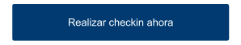

ONLINE CHECK IN & CHOOSE YOUR ROOM
You are about to complete an Online Check-in process from a guest´s perspective.
Please follow the intructions:
Put this presentation in full-screen view
Follow the user process by clickling on the yellow pointer.
Click on the blue pointer for further details.
Pre-arrival email
Guest selection
Personal data request
Choose your room (OPTIONAL)
Payment method guarantee
Confirmation page
Let´s get started
Confirmation email - Process COMPLETED!

Slide 12
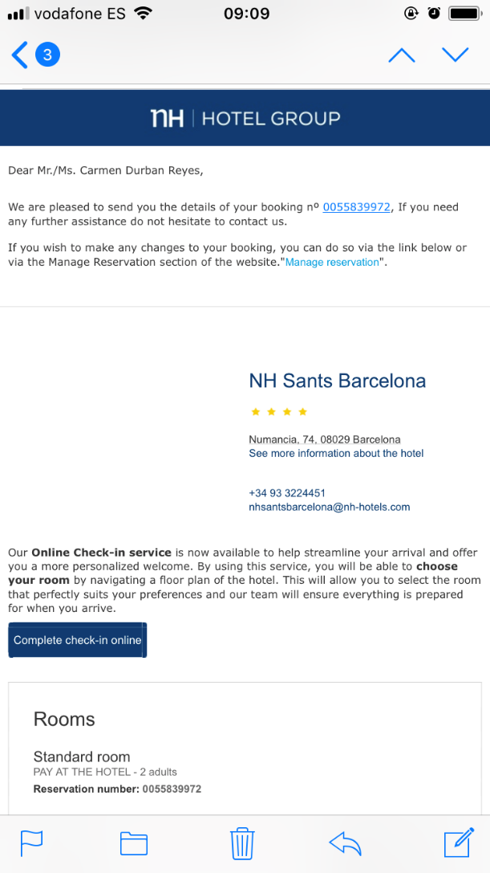
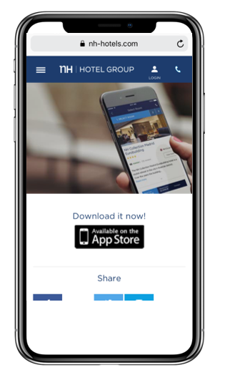
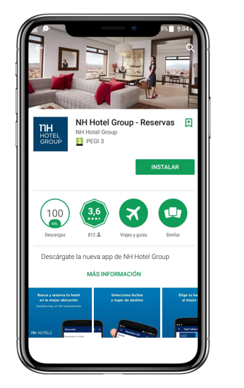
ONLINE CHECK IN & CHOOSE YOUR ROOM
Pre-arrival email
M
T
W
T
F
S
S
10 am
Guest selection
Guest receives the pre-arrival email approx. 10 am two days before arrival. Service will be open until 12:00 p.m day of arrival.
For phase 1, if Guest doesn't have the NH APP installed, a landing page will appear offering the download
Personal data request
Choose your room (OPTIONAL)
Payment method guarantee
Confirmation page
Confirmation email - Process COMPLETED!

Slide 13
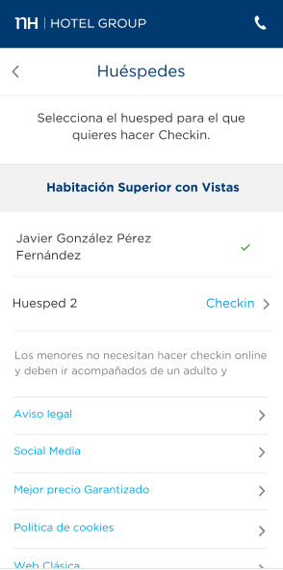
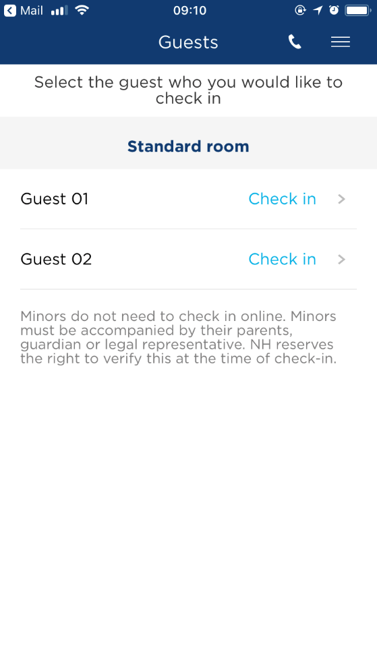

ONLINE CHECK IN & CHOOSE YOUR ROOM
Pre-arrival email
Guest selection
Personal data request
Following GDPR regulations Guest page list will not show the names of the Guest.
Guest 1
Choose your room (OPTIONAL)
Guest 2
Due to legal restrictions, minors (under 18) cannot do their Check-in online. They will always have to go to Front desk.
Payment method guarantee
Confirmation page
Confirmation email - Process COMPLETED!

Slide 14
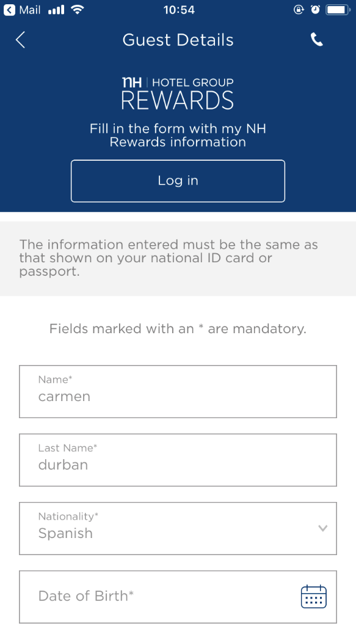



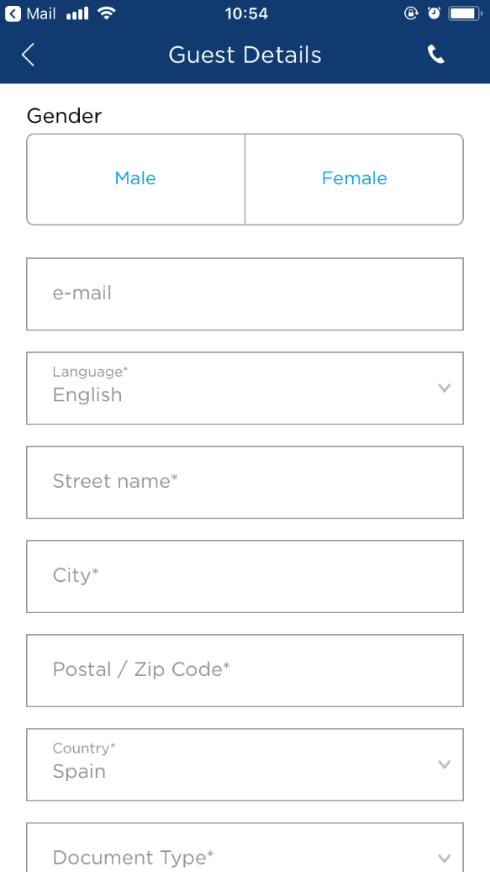
ONLINE CHECK IN & CHOOSE YOUR ROOM
Pre-arrival email
Guest selection
Personal data of NH Rewards members will be automatically uploaded from our CRM system when they log in.
Personal data request
Choose your room (OPTIONAL)
Rest of guest will have to introduce their personal data as required
Payment method guarantee
Confirmation page
Confirmation email - Process COMPLETED!

Slide 15
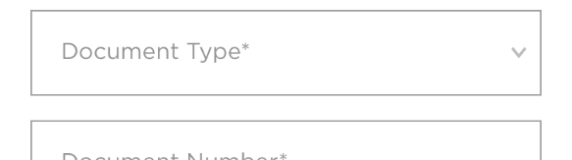
ONLINE CHECK IN & CHOOSE YOUR ROOM
Pre-arrival email
Guest selection
Guest will access to the same registration form, as now regulated by GDPR, so all legal information needed for the check-in will be requested, as mandatory, to go to next page.
The online data registration form will be different depending in the Guest nationality and the country where guest is going to stay.
Email collected in this form will be used only to send the OCI confirmation process and can not be used for other purposes unless we have written consent acquired at front desk check-in.
Personal data request
Choose your room (OPTIONAL)
Payment method guarantee
Confirmation page
Confirmation email - Process COMPLETED!

Slide 16

ONLINE CHECK IN & CHOOSE YOUR ROOM
Pre-arrival email
Guest selection
Personal data request
Choose your room (OPTIONAL)
NH Rewards membership
Payment method guarantee
General Terms & Conditions of any reservation consent
Confirmation page
Confirmation email - Process COMPLETED!

Slide 17

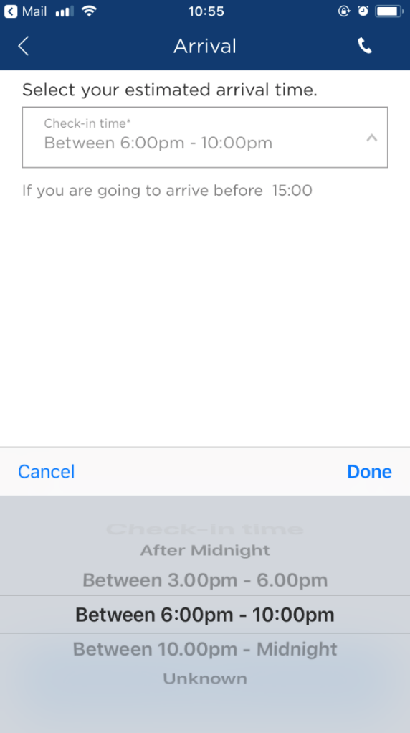
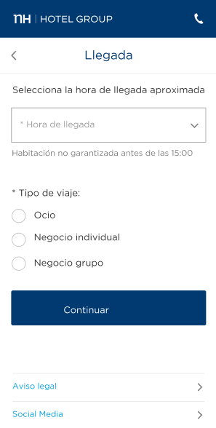
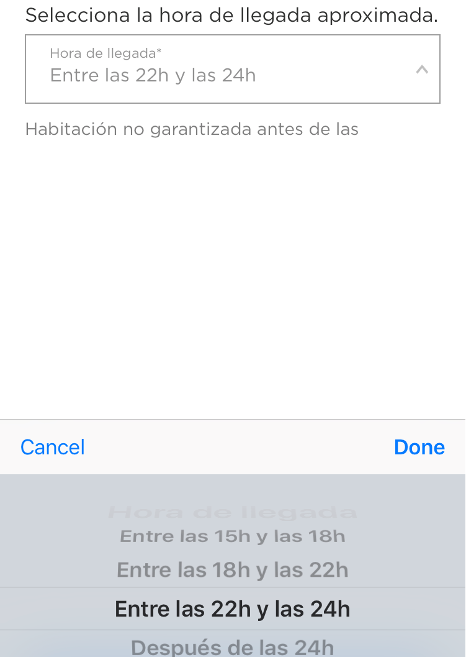
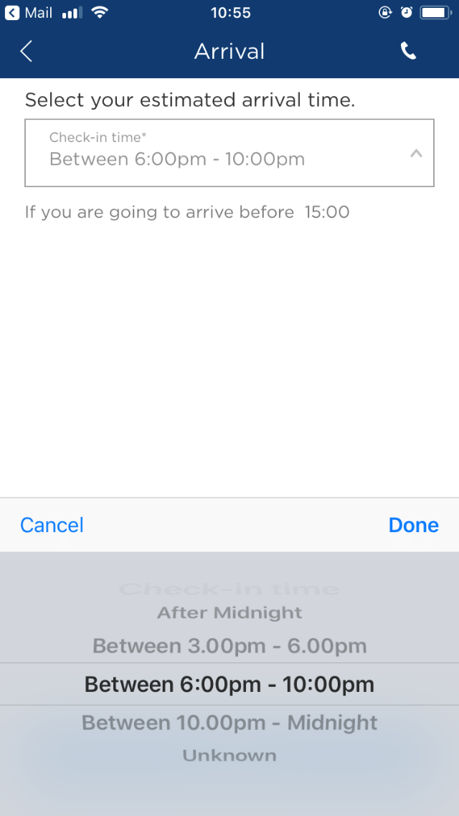
ONLINE CHECK IN & CHOOSE YOUR ROOM
Pre-arrival email
Guests can select their arrival time in the following time ranges:
  Unknown
  15:00 - 18:00 h
  18:00 – 22:00 h
  22:00 - 24:00 h
  After 24:00 h
TMS will save this information as:
A message will be displayed informing Guest to contact directly to the hotel if they want to arrive earlier.
Guest selection
If your are going to arrive before 15:00 please contact with the hotel.
Personal data request
Choose your room (OPTIONAL)
Guest selection | TMS
Unknown | No changes
15:00 - 18:00 h | 15:00 h
18:00 – 22:00 h | 18:00 h
22:00 - 24:00 h | 22:00 h
After 24:00 h | 24:00 h
Payment method guarantee
Confirmation page
Confirmation email - Process COMPLETED!

Slide 18
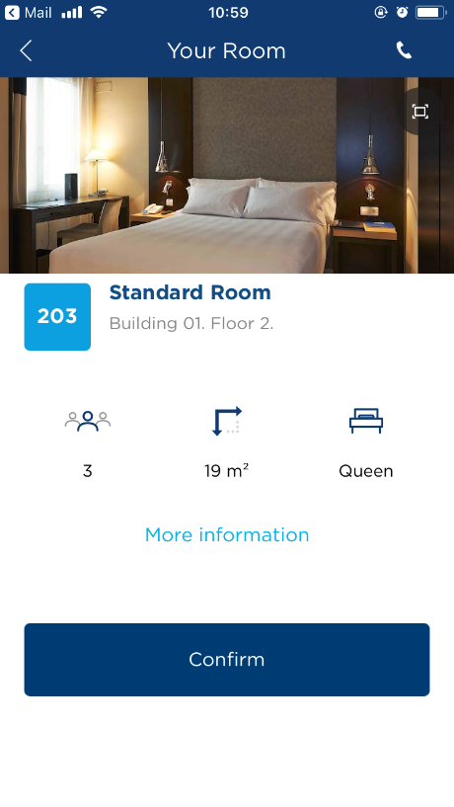
ONLINE CHECK IN & CHOOSE YOUR ROOM
Pre-arrival email
For reservations with a
PRE-ASIGNED ROOM (e.g. any reservation with a specific request: crib, extra bed,…, guest will not have the option to CHOOSE his ROOM.
He will be directed to the payment guarantee page.
If guest wants to change the room that has been pre-asigned, he must contact with front desk.
Guest selection
Personal data request
Note: Pre-asigned rooms
Choose your room (OPTIONAL)
Payment method guarantee
Confirmation page
Confirmation email - Process COMPLETED!

Slide 19
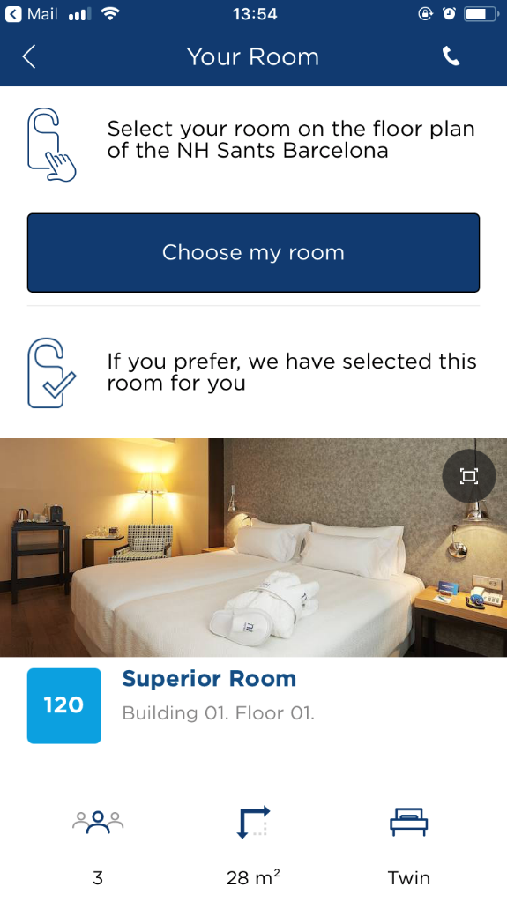
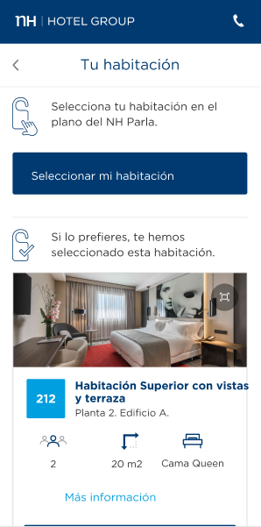
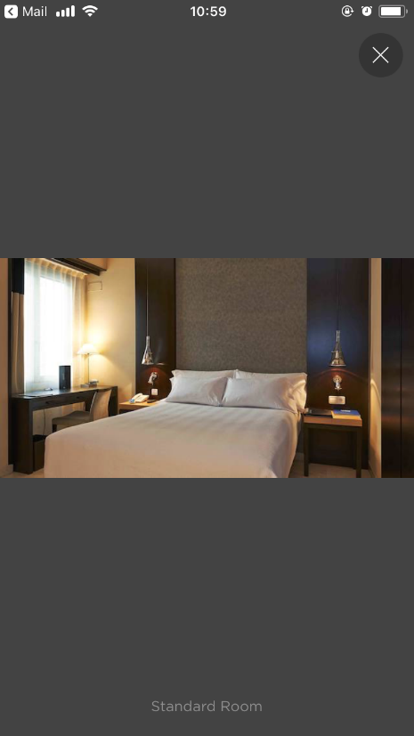
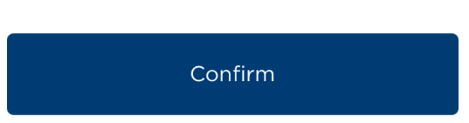
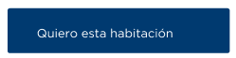
ONLINE CHECK IN & CHOOSE YOUR ROOM
For reservations with no pre-asigned room, guest will have two options:
Pre-arrival email
Guest selection
1. Guest can choose his room directly from the hotel floorplan.
Personal data request
Choose your room (OPTIONAL)
Payment method guarantee
Confirmation page
2. Or he will have the option to select a pre-asigned room.
Confirmation email - Process COMPLETED!

Slide 20
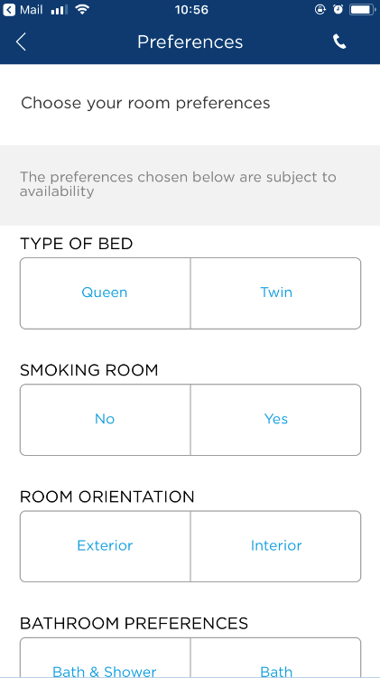
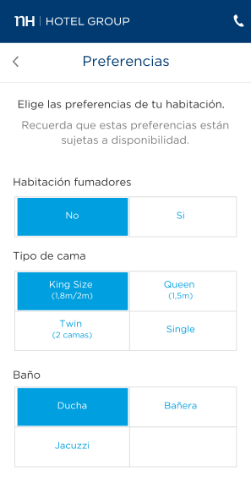
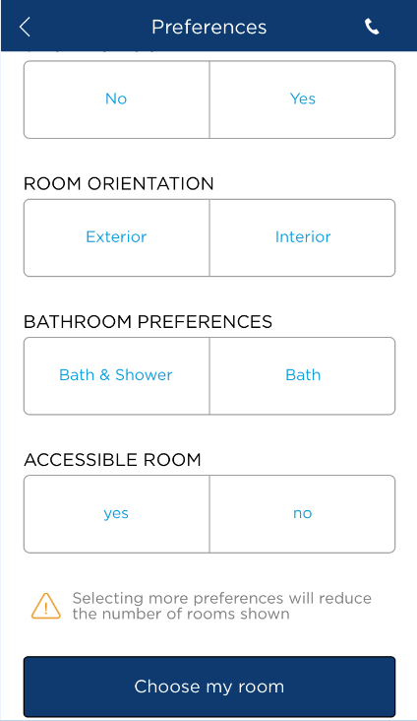
ONLINE CHECK IN & CHOOSE YOUR ROOM
Pre-arrival email
Guest will be able to select the 6 most important room characteristics.
(It is crucial that room characteristics in TMS are correctly informed)
Guest selection
Personal data request
Choose your room (OPTIONAL)
Preferences buttons are dynamic, meaning that they are only displayed if they are available in the hotel/room category.
e.g. if your hotel has Jacuzzis only in the Junior Suite category and a guest makes a reservation in a different room category (standard, premium, superior…) the Jacuzzi option will not be displayed.
Payment method guarantee
Confirmation page
Confirmation email - Process COMPLETED!

Slide 21
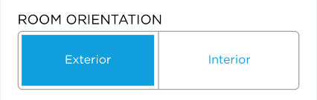

ONLINE CHECK IN & CHOOSE YOUR ROOM
Pre-arrival email
The total number of room characteristics selected by the guest, will impact on the rooms available displayed.
Guest selection
Personal data request
Choose your room (OPTIONAL)
Payment method guarantee
Confirmation page
Confirmation email - Process COMPLETED!

Slide 22
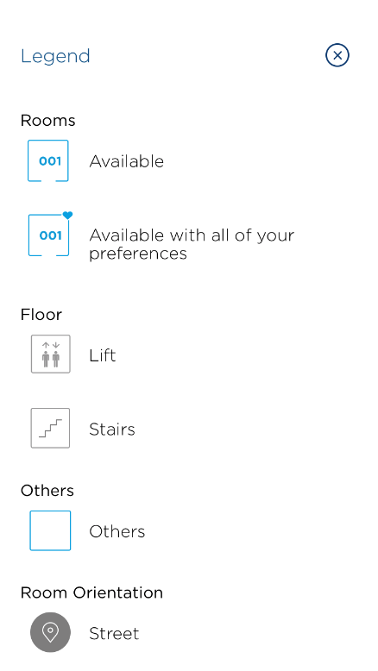
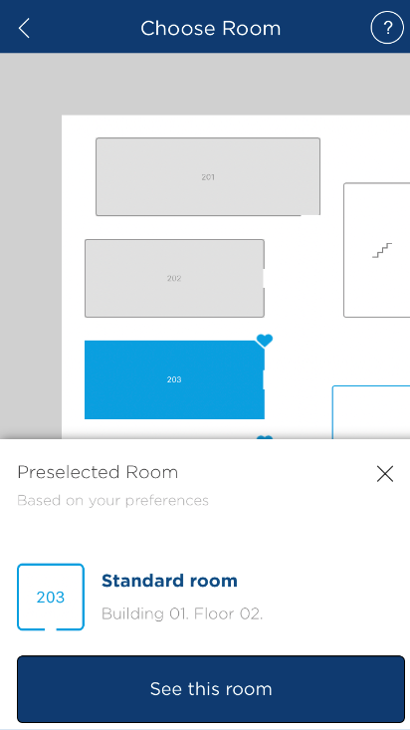




ONLINE CHECK IN & CHOOSE YOUR ROOM
Pre-arrival email
Information on the availability of the rooms is taken from TMS and it is updated in real time.
Guest selection
Guest will be able to see:
  Blue color rooms with a heart. 100% preferences covered.
  Blue color rooms without a heart, some pre-selected preferences are covered but not all.
In further phases of the project upselling functionality (green rooms) will be included.
Personal data request
Choose your room (OPTIONAL)
Payment method guarantee
Confirmation page
There will always be a pre-selected room, based on guest preferences
Confirmation email - Process COMPLETED!

Slide 23
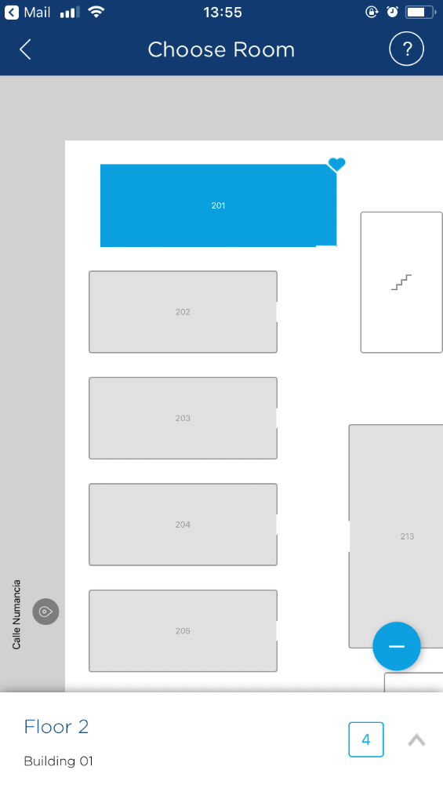
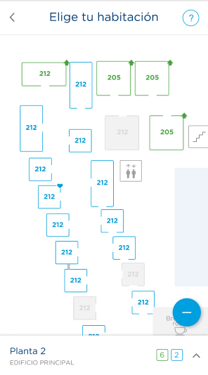
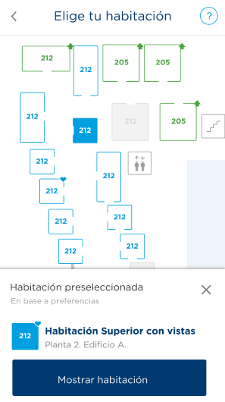
ONLINE CHECK IN & CHOOSE YOUR ROOM
Pre-arrival email
Guest selection
Personal data request
Choose your room (OPTIONAL)
Payment method guarantee
Confirmation page
Confirmation email - Process COMPLETED!

Slide 24
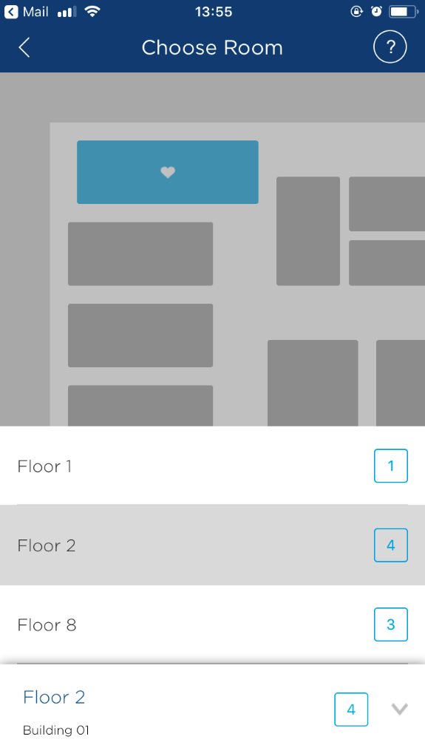
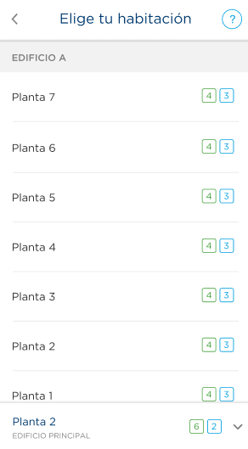
ONLINE CHECK IN & CHOOSE YOUR ROOM
Pre-arrival email
Guest selection
Personal data request
Choose your room (OPTIONAL)
Payment method guarantee
Confirmation page
Confirmation email - Process COMPLETED!

Slide 25
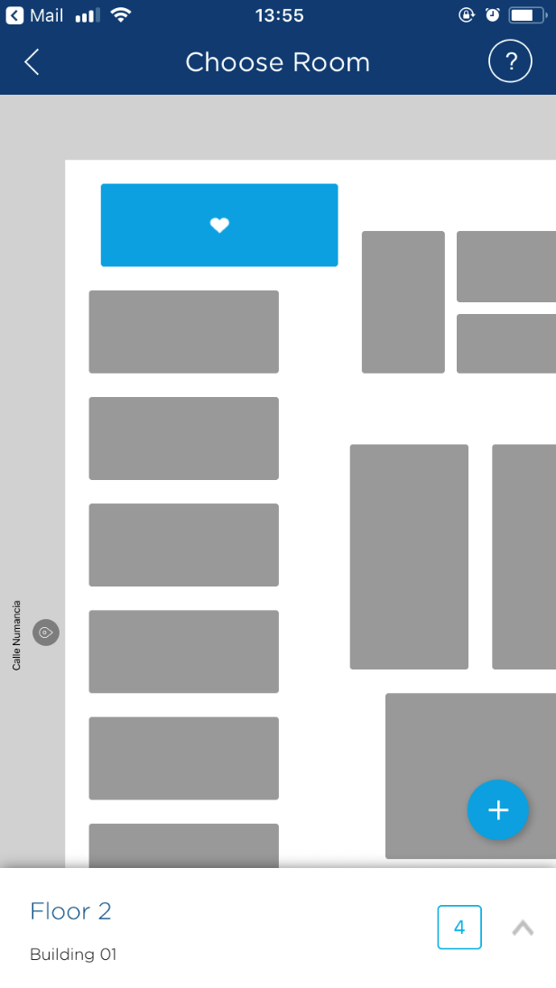
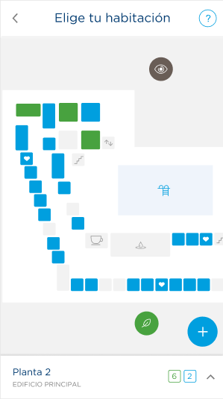




ONLINE CHECK IN & CHOOSE YOUR ROOM
Pre-arrival email
Guest selection
Guest will be able to see the views of the rooms:
  This icon represents green areas, such as parks or gardens.
  This icon represents the sea, a beach, a pool or a lake.
  This icon represents monuments or places of interest.
  This icon highlights the type of Street.
Personal data request
Choose your room (OPTIONAL)
Payment method guarantee
Confirmation page
Confirmation email - Process COMPLETED!

Slide 26


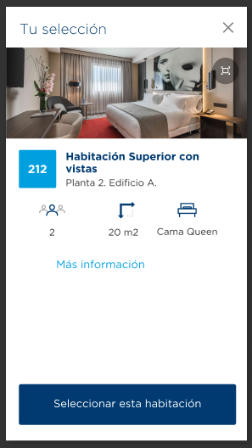
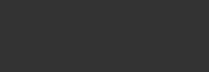
ONLINE CHECK IN & CHOOSE YOUR ROOM
Pre-arrival email
Guest selection
Personal data request
Choose your room (OPTIONAL)
Payment method guarantee
Confirmation page
Confirmation email - Process COMPLETED!

Slide 27
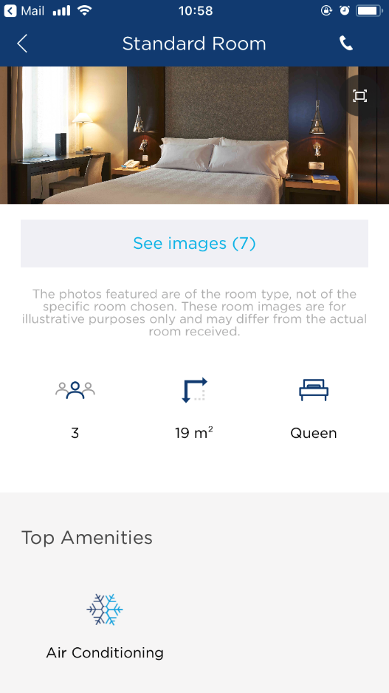
ONLINE CHECK IN & CHOOSE YOUR ROOM
Pre-arrival email
Guest selection
Room pictures are taken from the Web and correspond to the room category, not to the specific room selected. Guest will be informed accordingly in this page.
Personal data request
Choose your room (OPTIONAL)
Max occupancy & room size information is coming directly from the Web and is the same information shown during the WEB buying process referred to the typologies and not to the specific room selected.
The bed type information comes directly from TMS.
Payment method guarantee
Confirmation page
Confirmation email - Process COMPLETED!

Slide 28
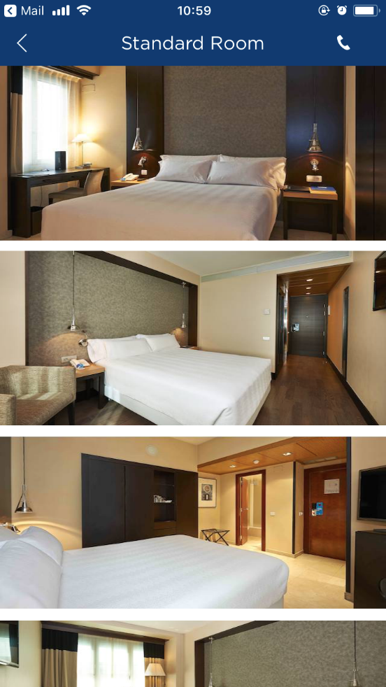
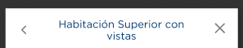
ONLINE CHECK IN & CHOOSE YOUR ROOM
Pre-arrival email
Guest selection
Personal data request
Room pictures are taken from the Web and correspond to the room category, not to the specific room selected.
Choose your room (OPTIONAL)
Payment method guarantee
Confirmation page
Confirmation email - Process COMPLETED!

Slide 29
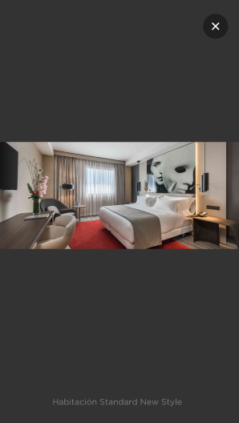
ONLINE CHECK IN & CHOOSE YOUR ROOM
Pre-arrival email
Guest selection
Personal data request
Choose your room (OPTIONAL)
Payment method guarantee
Confirmation page
Confirmation email - Process COMPLETED!

Slide 30
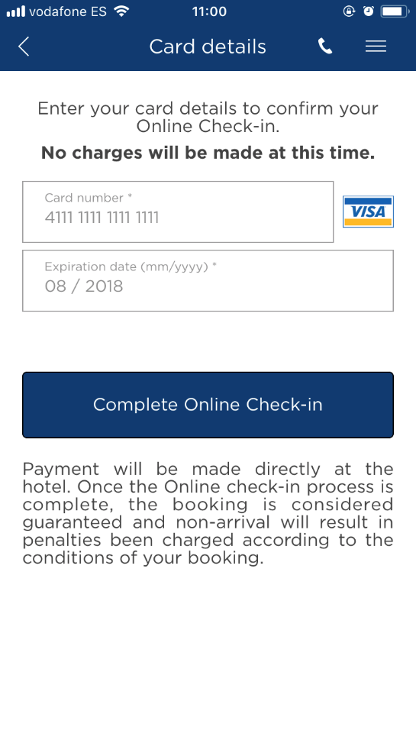
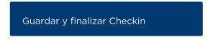
ONLINE CHECK IN & CHOOSE YOUR ROOM
Pre-arrival email
Credit card details are required to guarantee the stay (as it is normally done at front desk).
Hotel should apply the same
non-show policy that is currently in use for the guaranteed web reservation.
Guest selection
Personal data request
Choose your room (OPTIONAL)
Payment method guarantee
Confirmation page
Confirmation email - Process COMPLETED!

Slide 31
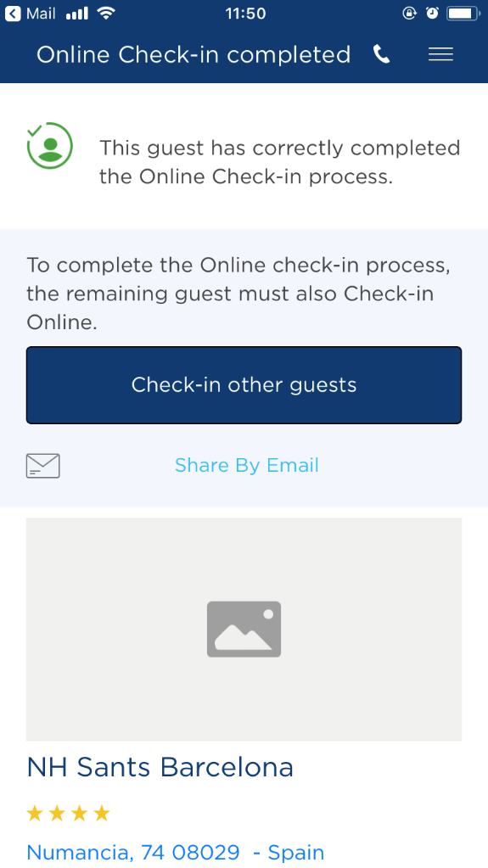

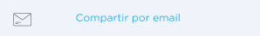
ONLINE CHECK IN & CHOOSE YOUR ROOM
Pre-arrival email
Guest selection
Personal data request
Even though it is not mandatory:
once the first guest has checked-in succesfully, we will inform him that if rest of guest do not complete the OCI, work will have to be done at Front Desk.
Choose your room (OPTIONAL)
Payment method guarantee
Confirmation page
Confirmation email - Process COMPLETED!

Slide 32
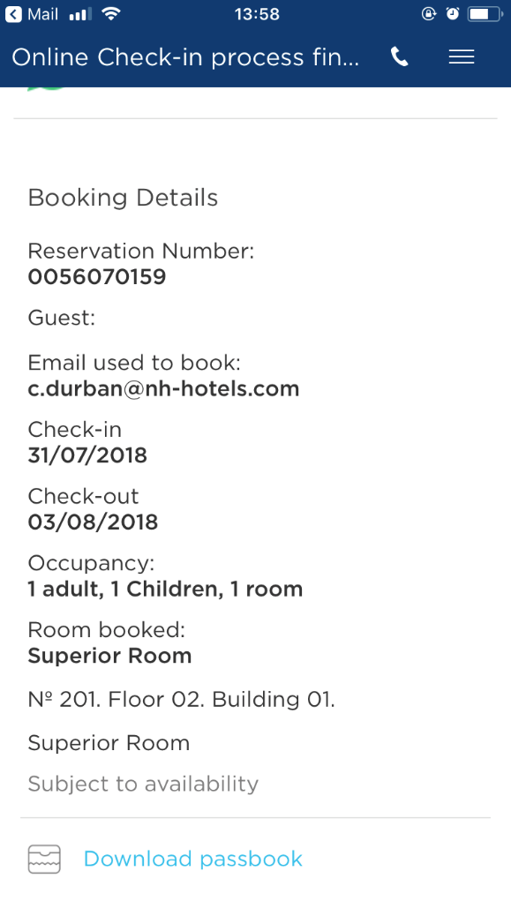
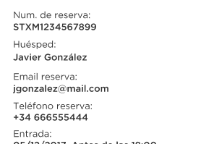
ONLINE CHECK IN & CHOOSE YOUR ROOM
Pre-arrival email
Guest selection
Personal data request
Confirmation page for the first guest.
Choose your room (OPTIONAL)
Payment method guarantee
Confirmation page
Confirmation email - Process COMPLETED!

Slide 33
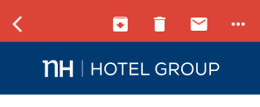


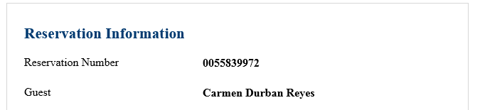
ONLINE CHECK IN & CHOOSE YOUR ROOM
Pre-arrival email
Guest confirmation email.
Guest selection
Dear Mr/Ms. Carmen Durban Reyes The Online Check-in process for your room 203 has been successfully completed. Everything will be ready for you when you arrive at the hotel. Here is your reservation nº: 0055839972;
When arriving at the hotel, as a user of our online check-in service, please go straight to the front desk to enjoy a faster and easier check-in.
To complete the Online Check-in process we need details of the remaining guests. You may forward this email to each of the guests so that they may complete their details. Once the Online Check-in has been completed with all guest’s information you’ll receive a confirmation email.
Personal data request
Choose your room (OPTIONAL)
Payment method guarantee
Confirmation page
Confirmation email - Process COMPLETED!

Slide 34
ONLINE CHECK IN & CHOOSE YOUR ROOM
Pre-arrival email
Guest selection
Second guest just have to complete the form.
Personal data request
Choose your room (OPTIONAL)
Payment method guarantee
Confirmation page
Confirmation email - Process COMPLETED!

Slide 35
ONLINE CHECK IN & CHOOSE YOUR ROOM
Pre-arrival email
Guest selection
Personal data request
Choose your room (OPTIONAL)
Payment method guarantee
Confirmation page
Confirmation email - Process COMPLETED!

Slide 36
ONLINE CHECK IN & CHOOSE YOUR ROOM
Pre-arrival email
Guest selection
Personal data request
Choose your room (OPTIONAL)
Payment method guarantee
Confirmation page
Confirmation email - Process COMPLETED!

Slide 37
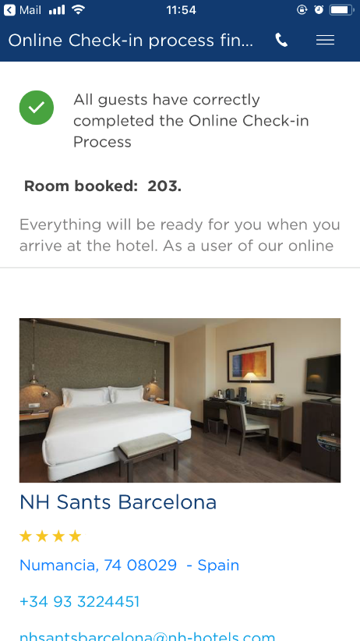
ONLINE CHECK IN & CHOOSE YOUR ROOM
ANNEX
Pre-arrival email
Guest selection
Confirmation page once ALL the guests are checked-in.
Personal data request
Choose your room (OPTIONAL)
Payment method guarantee
Process COMPLETED!

Slide 38


ONLINE CHECK IN & CHOOSE YOUR ROOM
Pre-arrival email
Once ALL the guests have completed the OCI process, they will receive this confirmation email.
Guest selection
Dear Mr/Ms. Carmen Durban Reyes The Online Check-in process for your room 203 has been successfully completed. Everything will be ready for you when you arrive at the hotel. Here is your reservation nº: 0055839972;
When arriving at the hotel, as a user of our online check-in service, please go straight to the front desk to enjoy a faster and easier check-in.
Personal data request
Choose your room (OPTIONAL)
Payment method guarantee
Warning text included in this page:
Under exceptional circumstances the hotel may need to reassign your room allocation, trying its utmost to respect and chosen preferences.
Confirmation page
Confirmation email - Process COMPLETED!

Slide 39
OCI GUEST JOURNEY
ONLINE CHECK IN & CHOOSE YOUR ROOM
RESERVATION
ONLINE PROCESS
ARRIVAL
Guest make a reservation
Guest receives a pre-arrival email which gives him access to the new service
Guest complete his personal data
Select his preferences
Guest can choose the room that suits him better
Enters guarantee payment data
ONLINE CHECK-IN COMPLETED
Guest receives a confirmation email
Goes to Priority desk (when existing)
Shows ID
Signs registration form
1
2
48 h before arrival
3
4
5
6
Hotel – as of 15:00 p.m. the day of arrival
GO TO ONLINE PROCESS
GO TO FRONT OFFICE GUIDE

Slide 40
ONLINE CHECK IN & CHOOSE YOUR ROOM
FRONT OFFICE GUIDE

Slide 41


DAILY WORKFLOW
ONLINE CHECK IN & CHOOSE YOUR ROOM
PRE-ASIGNED ROOMS
Remember that from now on, all guest that use the Online Check-in service, will have direct access to your room inventory two days before their arrival. (aprox 10 am two days before arrival) so before this time, it is important to:
  Make your room pre-assignment process before that time frame, to make sure you will be able to allocate your VIPs, regular guest, groups , crews, etc in the best possible area/room.
  On top of making your pre assignments on-time, for some specific periods , you will be able to:
    Block rooms: Any room blocked will not be visible for guest during the on-line process. Remember this room status impacts on availability and should be only used when the room / floor / Secondary Bulilding does not want to be occupied.
    Place room in Out of Service status: Out of service status rooms also will not be visible for our guest and this status does not impact availability.
  Make sure that the rest of heads of department involved (Housekeeping, Maintenance,…) are informed so they can act accordingly or make any changes if neccesary.

Slide 42
DAILY WORKFLOW
ONLINE CHECK IN & CHOOSE YOUR ROOM
DAILY PAPERWORK
Make sure before 15:00 p.m. front desk agents have prepared all the materials needed for the check-ins:
Access to the Online Check-in guest list (Remember: it is posible that only part of the guests of a room have completed the OCI process, in this case: you will have to register the rest of guests).
Verify there are not indicences with any preasigned room, reservations with late check-out,…
Pre-print: Registration form + Check-in Triptych + Police Factsheet (if applies). (Remember: due to GDPR legislation you should keep all the pre-printed files in a safe & out of sight place).
Configurate the room key.
PROCESS RECOMMENDATION:
Responsible of night audit can do the list of the online c-ins that have chosen their room so far and pre-print the forms needed.
Responsible of the next turn (between 12:00 and 15:00 a.m.) can complete the process so everything is ready for guests arrival.

Slide 43

DAILY WORKFLOW
ONLINE CHECK IN & CHOOSE YOUR ROOM
PRIORITY DESK
Product adquisition &
installation guidelines
What?
It is an exclusive counter where a more efficient service is offered speeding up the check-in process at reception when guests arrive at the hotel.
This Priority line will occupy one of the current reception positions that will be indicated with two elements:
Light projection + Digital frame
For whom?
This special service will be available to guests who have used the Online Check-in service and to Gold & Platinum Rewards members.
  Requirements
Hotel must have a minimum of 2 front desk officers on duty, at least from 13,30h to 23,00h.
If a hotel reduces the number of receptionists (e.g. during summertime) or it is not the normal check-in time of the day (e.g. during the early mornings), the priority desk can be switched off temporarily.

Slide 44
ONLINE CHECK IN & CHOOSE YOUR ROOM
TMS GUIDES

Slide 45




TMS GUIDES
ONLINE CHECK IN & CHOOSE YOUR ROOM
ENGLISH
SPANISH

Slide 47
ONLINE CHECK IN & CHOOSE YOUR ROOM
Pre-arrival email
Guest selection
Personal data request
Choose your room (OPTIONAL)
Payment method guarantee
Confirmation page
Confirmation email - Process COMPLETED!

