Slide 1
Room racks and
Room assignment module
BUSINESS PROCESSES – OPERATIONS
April 2025

Slide 2
New Room rack

Slide 3
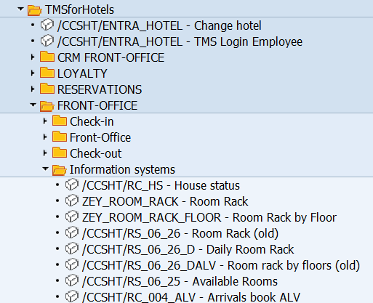
Room rack
Where is it located on the menu?

Slide 4
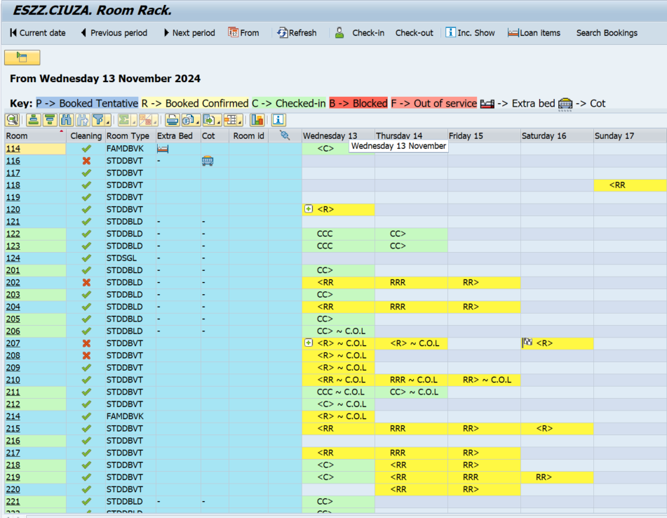
Room rack
The Room rack has been improved with more icons and options:
Extra bed and cot columns: this “-” sign means that the room doesn´t allow extra bed and/or cot.
Loan items: option to add/remove a “physical” extra bed and cot from rooms for the current day.
Search bookings: TMS proposes reservations by selecting the room line, clicking on Search bookings.
Drag and drop option. Change the reservation assignment and loan items by selecting the room line and simply moving it.
Filter menu on the same screen.
New icons (including day use) visible on the reservations.
2)
3)
5)
1)
6)
4)

Slide 5
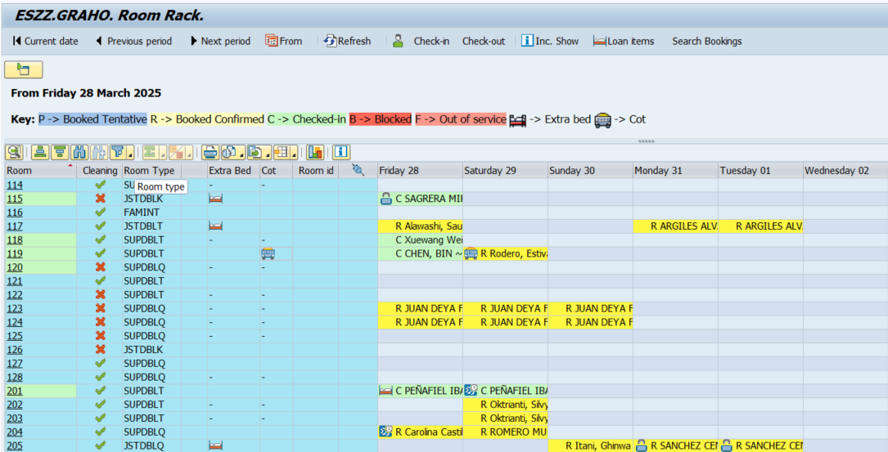
Room rack
1) Extra bed and cot columns will be displayed.
This “-” sign means that the room doesn´t allow extra bed and/or cot

Slide 6
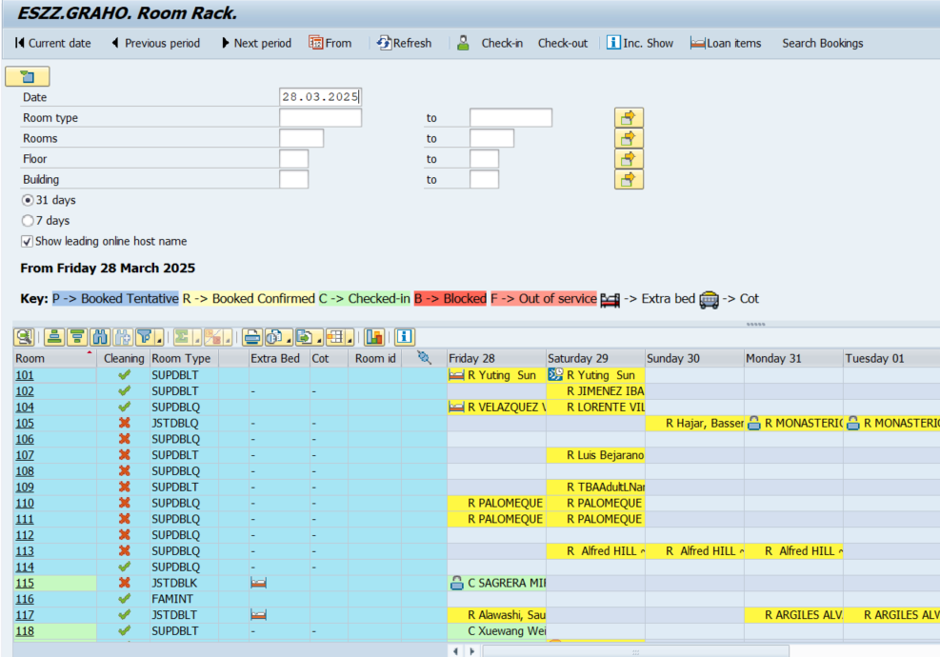
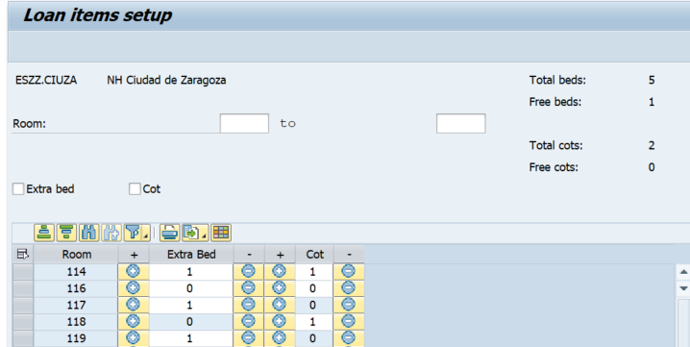
Room rack
2) Loan items
Option to add/remove a “physical” extra bed and cot from rooms for the current day.
This information does not apply to the reservation and is not available for future dates.
Click on Loan items
Loan items physical inventory updated.
The rooms where we can not inform a loan item is shaded, avoiding errors.

Slide 7
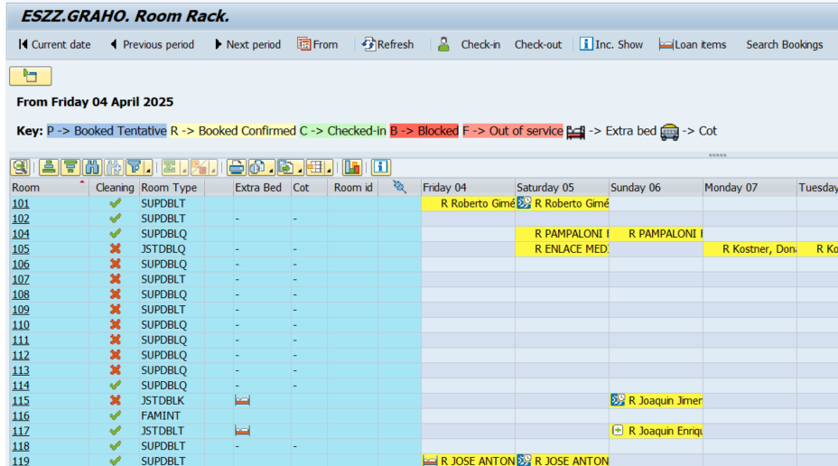
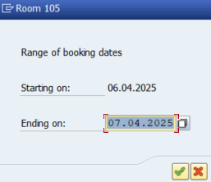
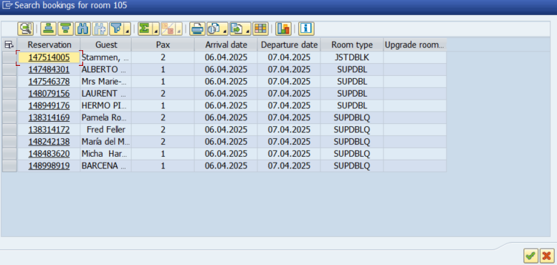
Room rack
3) Search booking
TMS proposes a list of reservations by selecting a "free" cell of the room and clicking on “Search reservations”.​
Now you can display and assign upgrades or even lower category rooms.
2
3
1

Slide 8
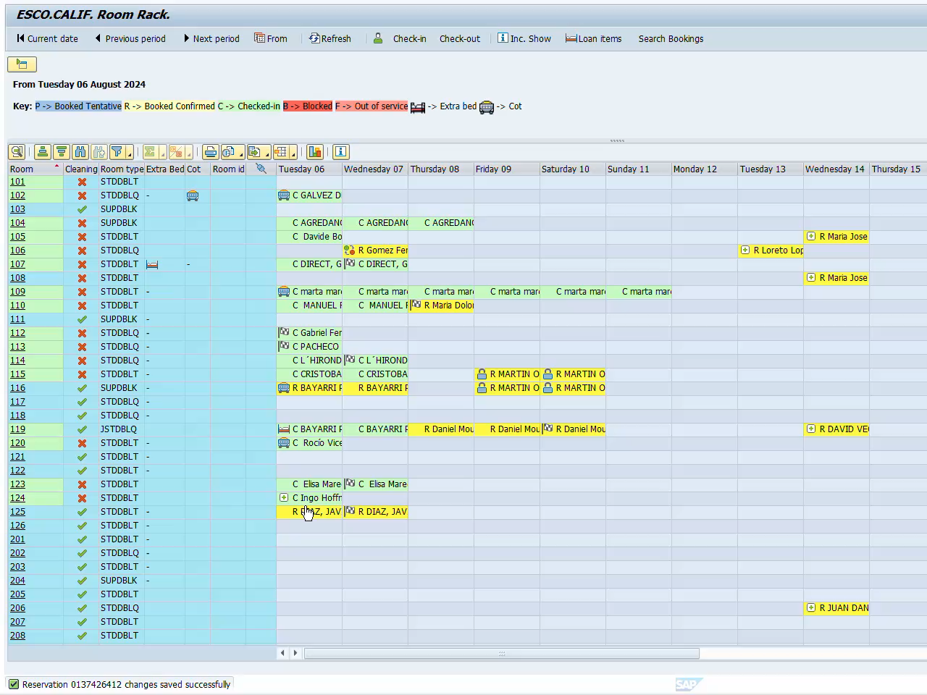
Room rack
4) Drag and drop option. Change the reservation assignment and loan items by selecting the room line and simply moving it.

Slide 9
Room rack
5) Filter menu on the same screen:
It can be used to display only certain room types or floors.

Slide 10
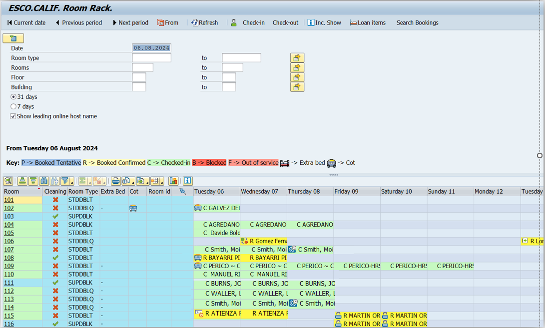
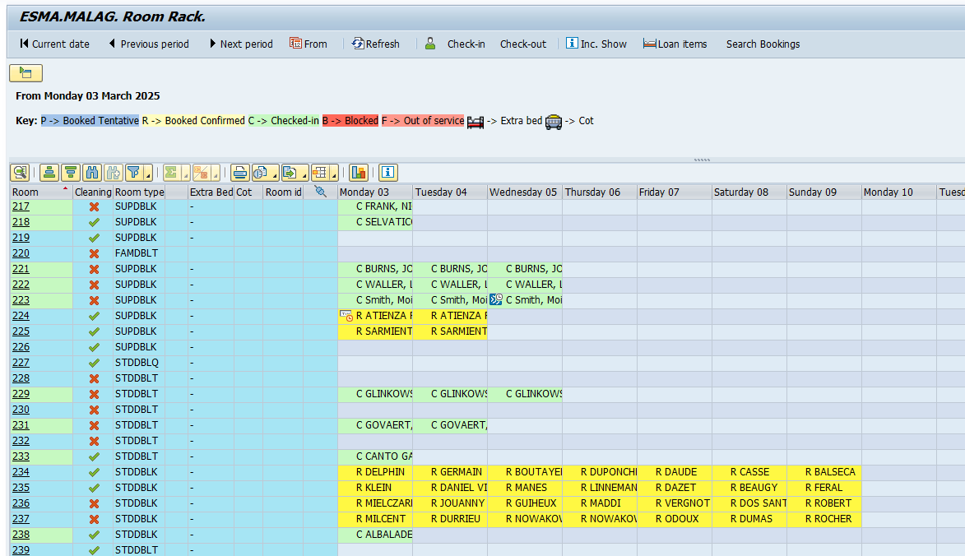

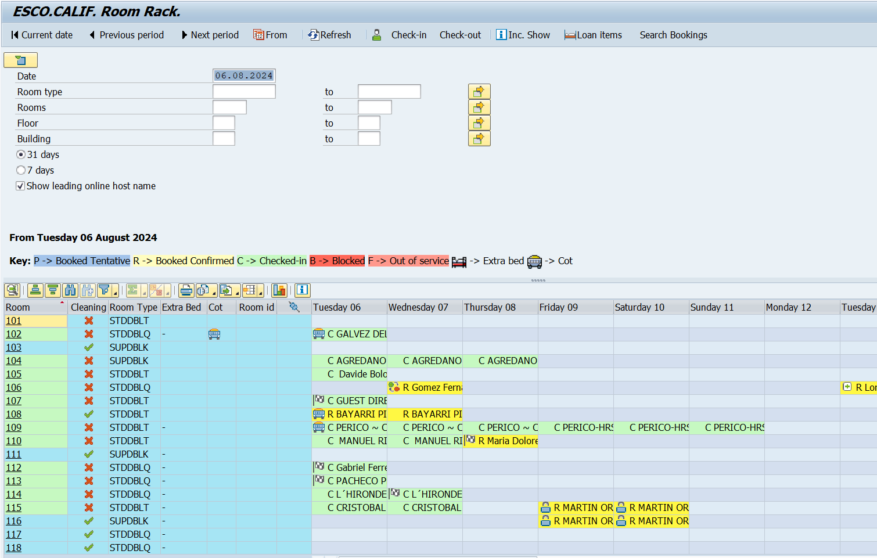
Room rack
6) New icons (including day use) visible on the reservations:
Extra bed
Cot
Late check out
Early check in
More than one stay option informed
No move
Day use

Slide 11
New Room rack by floor

Slide 12
Room rack by Floor
Where is it located on the menu?

Slide 13
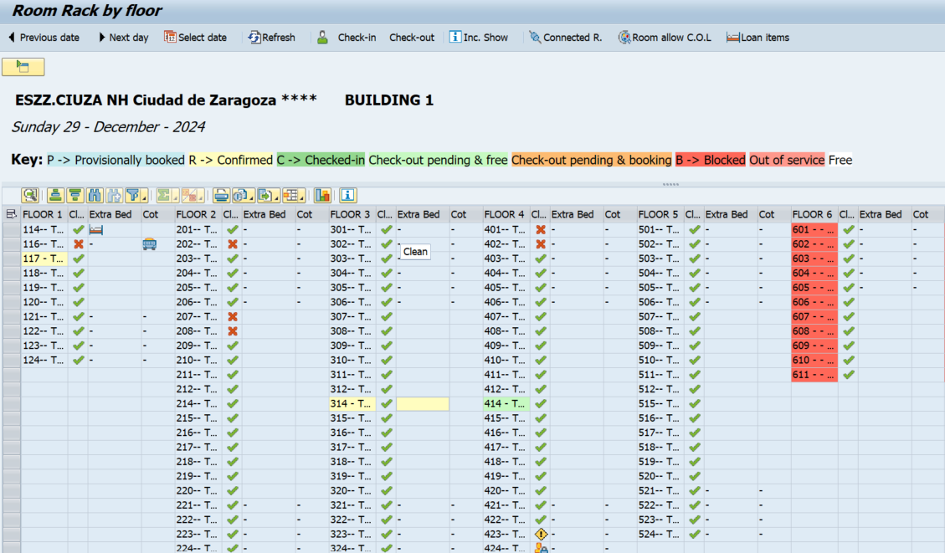
Room rack by floor
The Room rack by floor has been improved with more icons and options:
Extra bed and cot columns: this “-” sign means that the room doesn´t allow extra bed and/or cot.
Loan items: option to add/remove extra bed and cot from the rooms for the current day.
Reservations with loan item informed.
Drag and drop option. Change the reservation assignment and loan items by selecting the room line and simply moving it.
Filter menu on the same screen.
5)
2)
1)
4)
3)

Slide 14
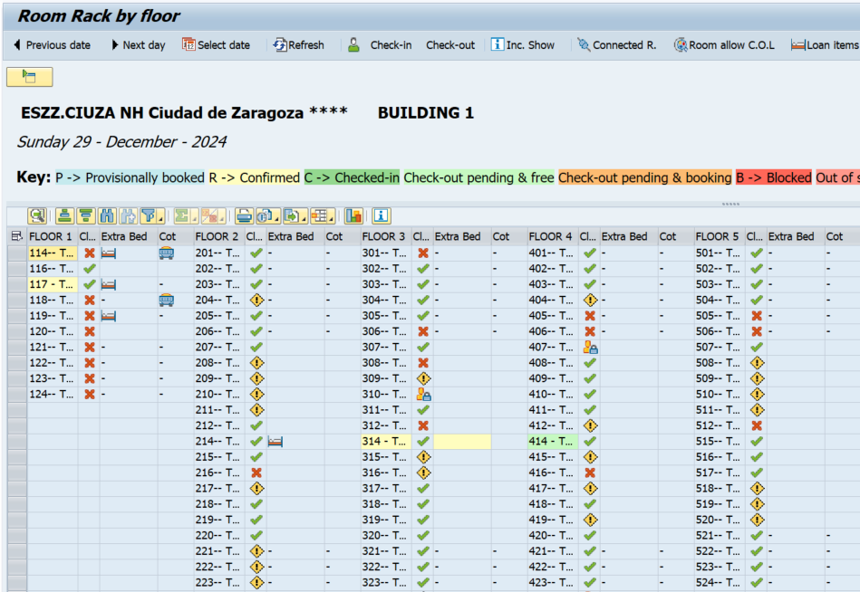
Room rack by floor
1) Extra bed and cot columns will be displayed.
This “-” sign means that the room doesn´t allow extra bed and/or cot

Slide 15
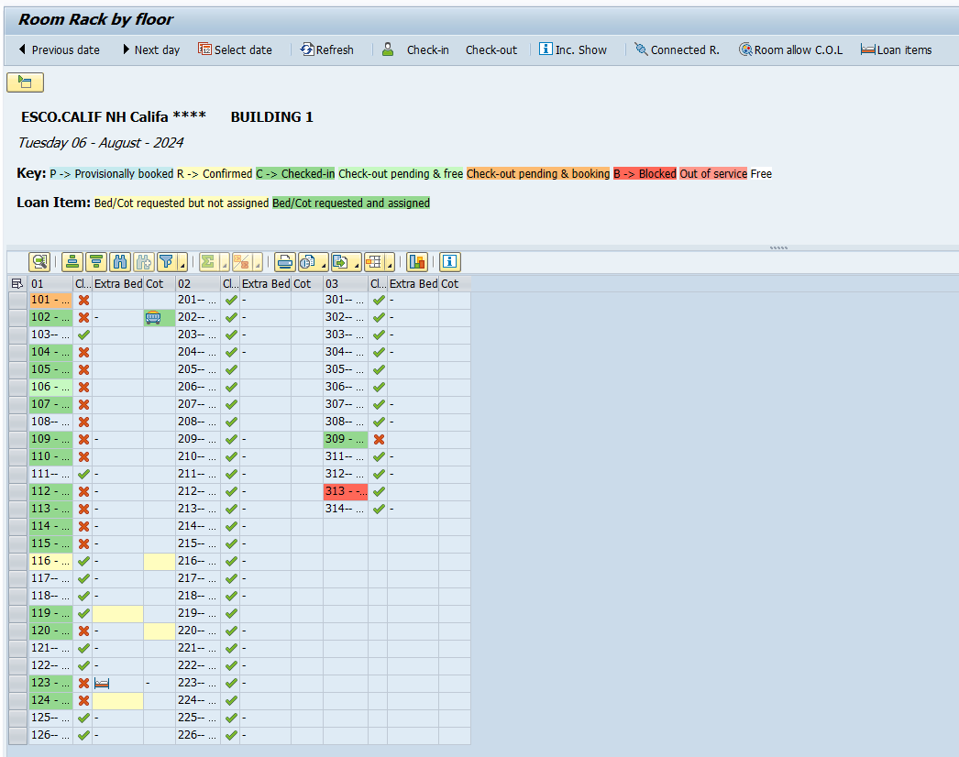
Room rack by floor
2) Loan items
Option to add/remove a “physical” extra bed and cot from rooms for the current day.
This information does not apply to the reservation and is not available for future.
Click on Loan items
Loan items physical inventory updated.
The rooms where we can not inform a loan item is shaded, avoiding errors.

Slide 16
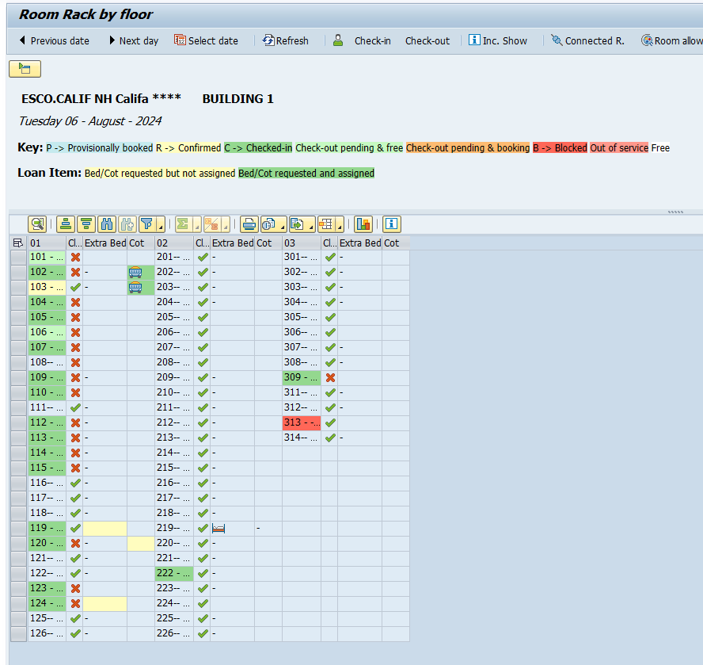
Room rack by floor
3) Reservations with loan item informed
The yellow cell in loan item column means this reservation has a loan item informed.
The green cell in loan item column means this reservation has a loan item informed and it is already physically assigned to the room.

Slide 17
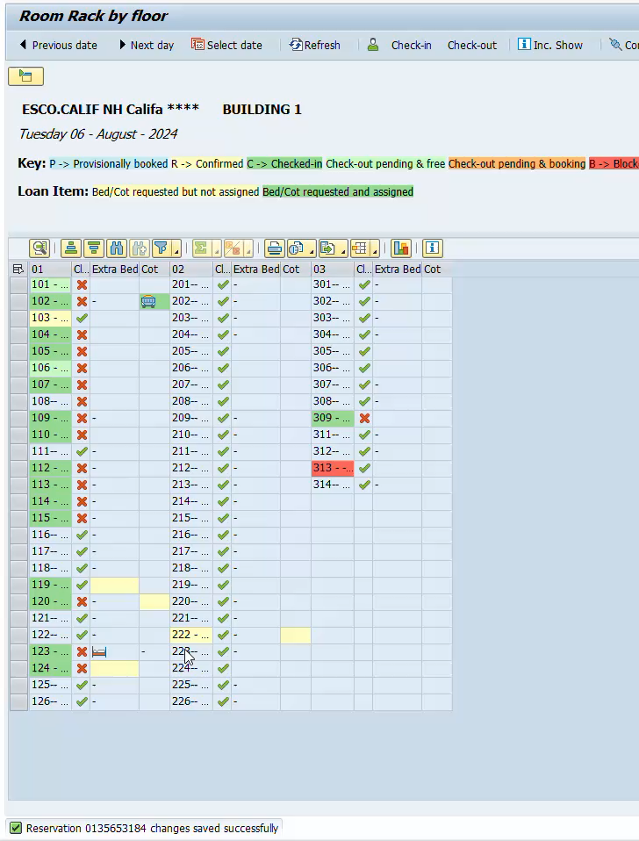
Room rack by floor
4) Drag and drop option. Change the reservation assignment and loan items by selecting the room line and simply moving it.

Slide 18
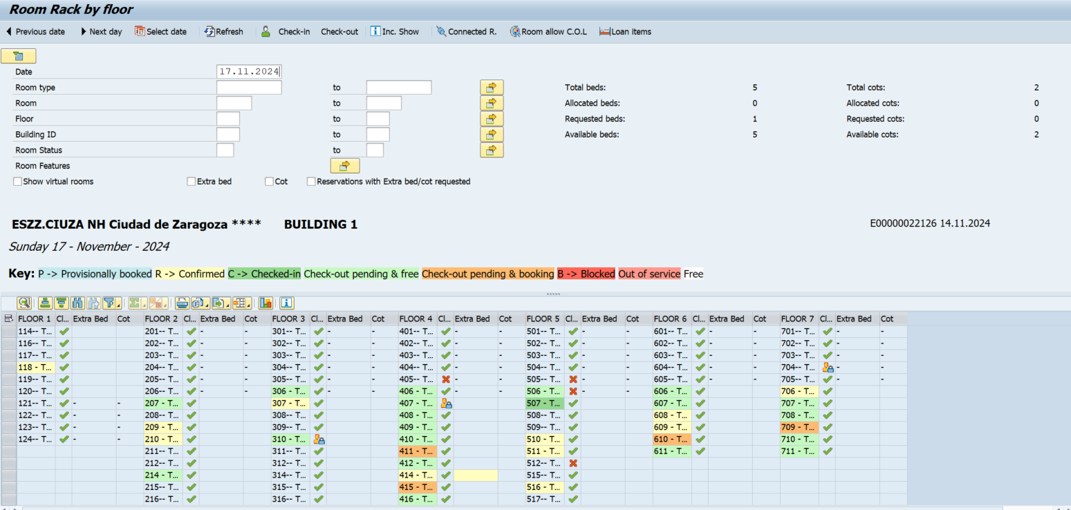
Room rack by floor
5) Filter menu on the same screen.
Loan items inventory
Extra filters
It can be used to display only certain room types or floors.

Slide 19
Room assignment module

Slide 20

Assignment module
This tool is designed to manage and allocate rooms to guests efficiently. It helps streamline the process of assigning rooms based on various criteria such as guest preferences, room availability, and special requests. This module ensures that guests receive the best possible experience by matching their needs with the available rooms.

Slide 21

Global settings
TMS will propose room assignments based on top rooms, CRM profile, and reservation preferences. The DISCOVERY tier and VIP tier will have a predefined percentage applied. This global configuration has been defined by company decision.
DISCOVERY Red
DISCOVERY Platinum
DISCOVERY Gold
DISCOVERY Titanium
DISCOVERY Silver
- TOP ROOMS +
VIP 01
VIP 03
VIP 04
VIP 02
VIP 05
- TOP ROOMS +
There is the possibility to include more variables such as Channel, Segment, Subsegment and Contract/rate. However, we will start with these options: : VIP and DISCOVERY tier.
VIP standards by brand do not change and are available on the Business Processes website
MINOR HOTELS | Assignment module
Notes:
I

Slide 22
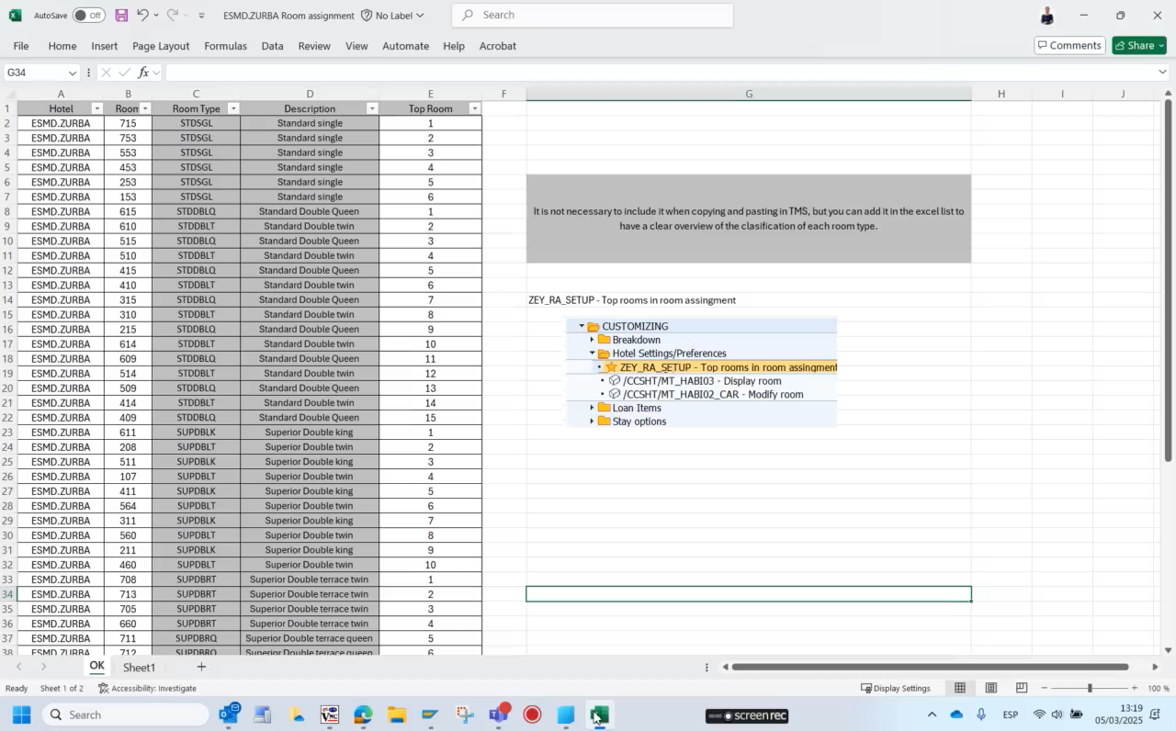
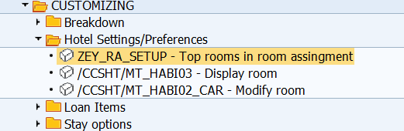
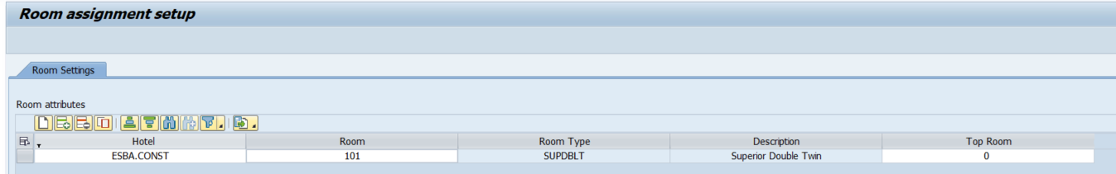
Hotel settings - Top rooms
The transactions is in:
Customizing → Hotel Settings/Preferences → Top rooms in room assignment
How to inform top rooms:
Manually
Access to transaction Top rooms in room assignment
Select your hotel
Select the room, we recommend type it directly
In “top room” column, write the number of the position of the room type
Massively:
Fill in the Excel
Access to this transaction Top rooms in room assignment
(Check the video)
3) Select the list CTRL+C
4) Click on the first line CTRL+V

Slide 23
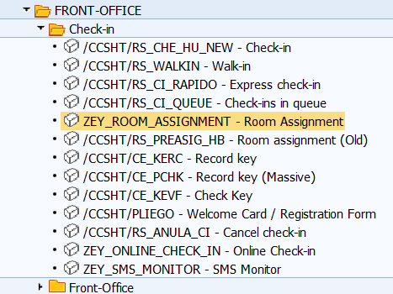
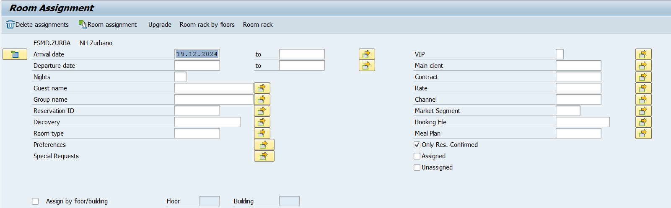
Room assignment module
Transaction and Filters
The transactions is in:
Front Office → Check in → Room Assignment
There are multiple choices and shortcuts on the filter screen:
Arrival date
Discovery
Preferences
VIP
…

Slide 24
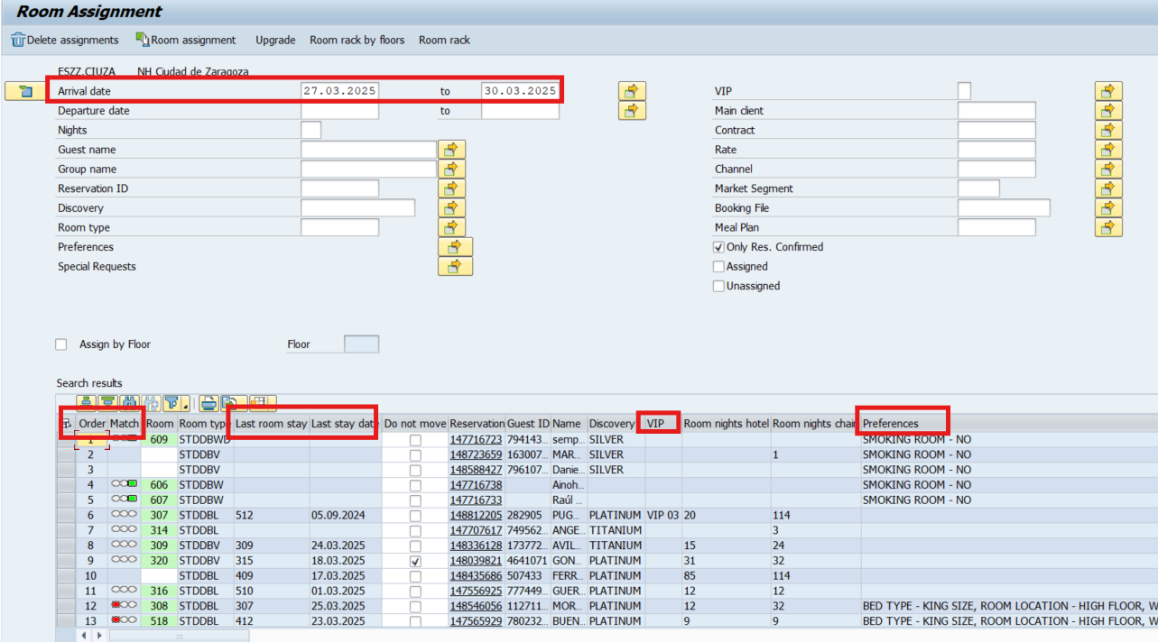
Room assignment module
After selecting the date or dates, by pressing “enter”, the reservations of the dates selected will be displayed.
If there is any reservation already assigned, a traffic light (column called Match) will show if the room assigned meets the preferences and the coincidence percentage:
Green: all the preferences are matched
Yellow: some preferences are matched
Red: preferences are not matched
White: there are not preferences to validate
Reservations will be ordered hierarchically based on a series of predefined criteria.

Slide 25
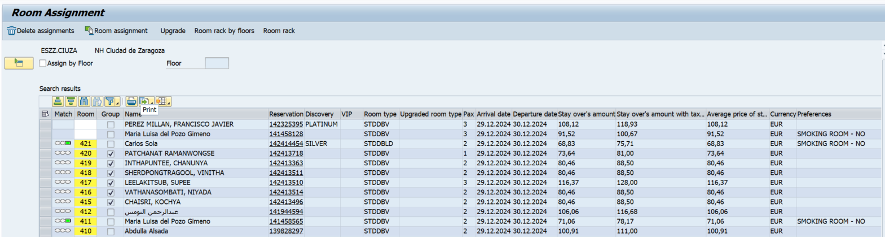

Room assignment module
By clicking Room assignment or Delete assignments the rooms of the selected lines will be assigned or removed massively.
You can do it by floor and building.
Select the reservation or reservations → click on “room assignment” → you will see a proposal of rooms → save if you agree.

Slide 26
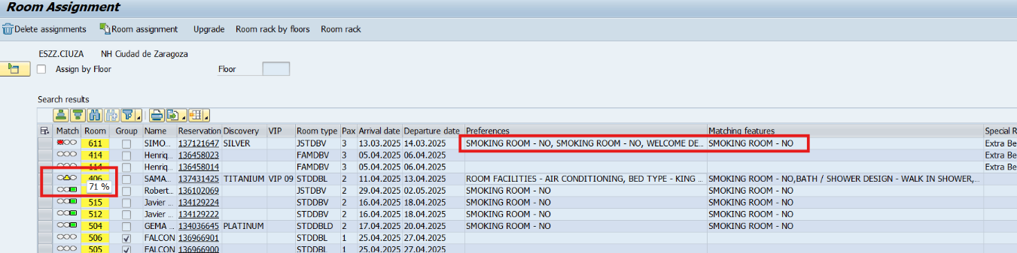
Room assignment module
You can create your own layout and be able to display:
Price per night and stay.
VIP, preferences, loan items, special request.
Room night per hotel, per chain, ID of the last reservation.
Matching features column.
Many more details.

Slide 27
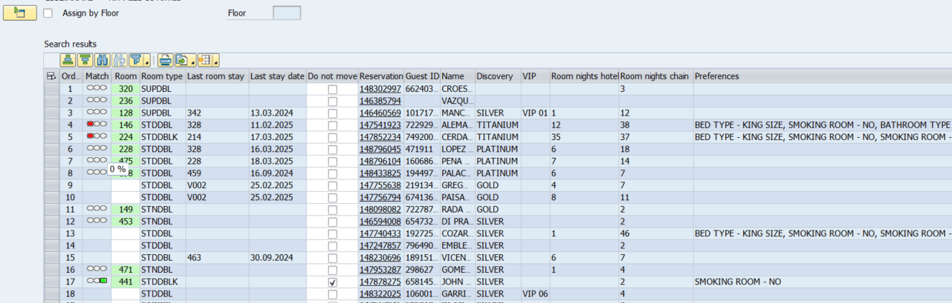
Room assignment module
Example to know how to understand the results:
The first reservations have loan items informed, for this reason they are the first ones in the order.
146 has shower instead of bathroom, so room doesn’t match the preference.
224 there are two preferences smoking and no smoking room.
The reservation with VIP 6 is not in the first positions because the company has defined 5 VIP levels only.

Slide 28
Thank you

