Slide 1
ONLINE CHECK - OUT
Front Desk Guide
Experience Design & Innovation | Marketing
JANUARY 2024

Slide 2

Contents
Online Check-Out
01
Benefits
02
Requirements
03
TMS Guide
04
User Guide
05
Onsite Communication
06

Slide 3
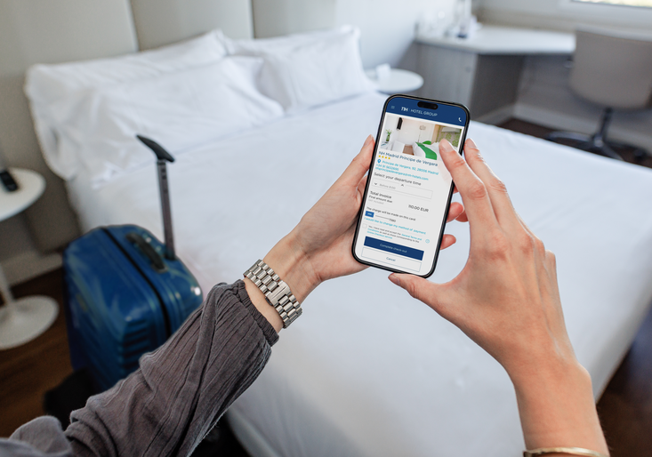
01. Online Check-Out
Online Check-Out is a service that will allow our guests to do their check-out completely on their mobile devices.
Guests will receive an email and they must complete all the simple steps that will be described in chapter 5 “User guide” of this document.
Once they have finished, they will receive the invoice/s by email, they should leave their key in the room, and they will be ready to go.

Slide 4

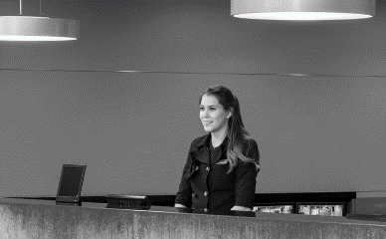


02. Benefits
WHAT ARE THE ADVANTAGES OF USING THIS NEW SERVICE?
BENEFITS FOR THE FRONT DESK
BENEFITS FOR OUR GUESTS
By offering this service, the benefits are:
Spending less time on manual procedures
Reducing queues & workload picks at check-out time
Being part of an innovative project
Taking care of the environment by promoting this eco-friendly initiative
Having the opportunity to offer solutions adapted to our guests´ lifestyle
By using this service, guest will:
Save time for themselves
Have their bill at their mobile
Avoid queues on peak time
Take care of the environment by using this eco-friendly initiative

Slide 5
03. Requirements
WHAT DO YOU NEED BEFORE YOU START AN ONLINE CHECK-OUT PROCESS?
1
2
CREDIT CARD
PRE-AUTHORIZATION
A VALID E-MAIL FROM THE GUEST IN CRM
Please remember that this amount is only suggested automatically by the system, but it can be modified manually depending on the daily situation
** Full credit guests will be excluded

Slide 6
04. TMS Guides
Below you will find all the information about the process to follow in our systems when a guest wants to check out online, as well as the different cases that can happen.
TMS MANUAL
INTERACTIVE GUIDE
*Please, log in TMS4H before you open the guides
TMS manual offers detail information to understand how the TMS works for this service. It also includes FAQ, best practices, reports and issues.
The interactive guide are a simulation of how the TMS should be managed based on these 3 cases:
TMS4H_ONLINE CHECK OUT (OCO)
TMS4H_ACTIVATE ONLINE CHECK OUT
TMS4H_ONLINE CHECK OUT STATUS
TMS4H_CANCEL ONLINE CHECL OUT

Slide 7


05. User Guide
Hello!
You are about to complete an Online Check-out process from a guest´s perspective.
Please
Put this presentation in full-screen view
Follow the user process by clickling on the pointer.
Let´s get started

Slide 8

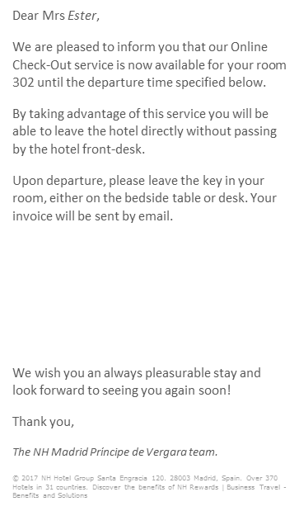


05. User Guide
Back
Once the OCO process is activated by the Front Desk, the guest will automatically receive an email at 18:00 p.m. the night before his departure.
In case guest does not access the email, a reminder email will be sent at 7:30 a.m. of the day of departure.
To start the OCO process, the guest should click on Check-out now
*(In Italy they will receive only the one at 7.30 of the day of departure because it is not legal to close invoices in advance)

Slide 9

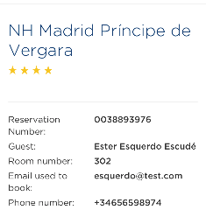



05. User Guide
Back
Data review
Invoice details
Departure time selection
The guest will be able to review his personal data & billing details.
Payment method
Terms & Condicions
COMPLETED!

Slide 10
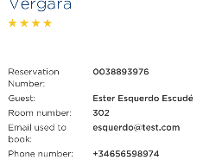
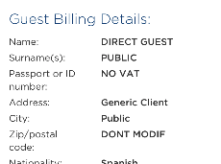
05. User Guide
Back
Data review
Invoice details
Departure time selection
The guest will be able to review his personal data & billing details.
Payment method
Terms & Condicions
COMPLETED!

Slide 11
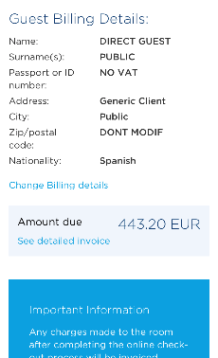


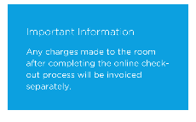
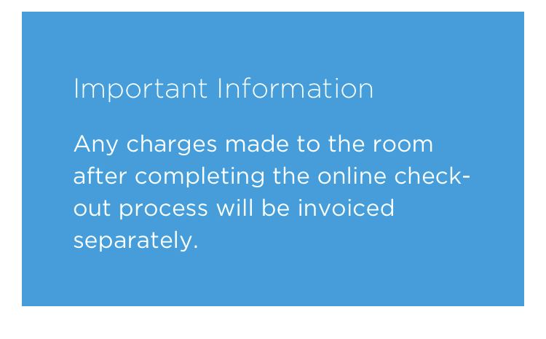
05. User Guide
Back
Data review
Invoice details
Departure time selection
Payment method
To prevent our guests from making changes in CRM, they will not be able to change the billing details by themselves.
If the guest clicks on Change billing details, he will receive a KO message.
Terms & Condicions
COMPLETED!

Slide 12
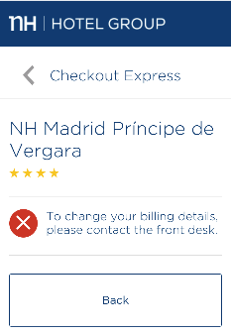
05. User Guide
Back
Data review
Invoice details
Departure time selection
Payment method
The guest will be redirected to Front Desk.
Terms & Condicions
COMPLETED!

Slide 13
05. User Guide
Back
Data review
Invoice details
Departure time selection
If the guest wants to have more information on the charges, he will click on See detailed invoice
Payment method
Terms & Condicions
COMPLETED!

Slide 14
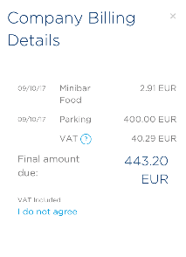



05. User Guide
Back
Data review
Invoice details
If charges are ok, the guest can close the box and continue with the process.
Departure time selection
Payment method
Our guests cannot change the billing details by themselves.
If a guest does not agree with his billing details, and he clicks I do not agree, he will receive a KO message.
Terms & Condicions
COMPLETED!

Slide 15
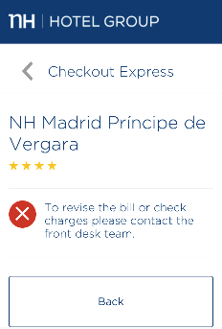
05. User Guide
Back
Data review
Invoice details
Departure time selection
Payment method
Terms & Condicions
The guest will be redirected to Front Desk.
COMPLETED!

Slide 16
05. User Guide
Back
Data review
Invoice details
Departure time selection
Payment method
Our guests will be informed that any charges made to the room after completing this process will be charged in a separate invoice.
Terms & Condicions
COMPLETED!

Slide 17
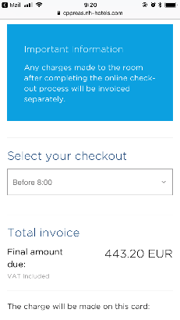


05. User Guide
Back
Data review
Invoice details
Departure time selection
Payment method
Our guest can also select his departure time.
Terms & Condicions
COMPLETED!

Slide 18
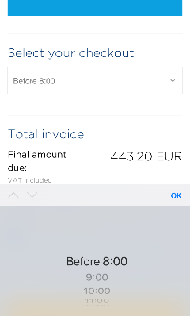


05. User Guide
Back
Data review
Invoice details
Departure time selection
Payment method
The guest can choose the option that suits him better and click OK.
Terms & Condicions
COMPLETED!

Slide 19

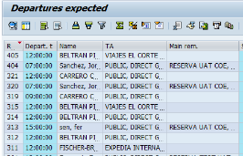
05. User Guide
Back
Data review
You will have the information of the departure time selected by each guest available in TMS:
/CCSHT/RS_RSRV_IN_02 - In-house management, Additional Data tab
/CCSHT/RS_06_02_ALV - Expect. Depart. ALV
ZEY_CHECKOUT_EXP - Online Check-out
Invoice details
Departure time selection
Payment method
Terms & Condicions
COMPLETED!

Slide 20
05. User Guide
Back
Data review
Invoice details
Departure time selection
Payment method
Terms & Condicions
COMPLETED!

Slide 21
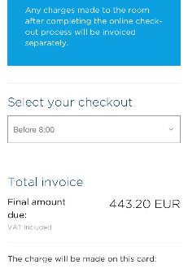
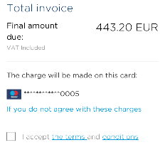

05. User Guide
Back
Data review
Invoice details
Departure time selection
Payment method
Terms & Condicions
COMPLETED!

Slide 22

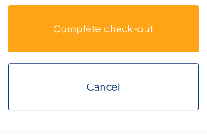
05. User Guide
Back
Data review
Invoice details
Departure time selection
Payment method
The guest will also check the payment method and if he does not agree, he can click on change the payment method.
The guest cannot change the payment method by himself so he will receive a KO message.
Terms & Condicions
COMPLETED!

Slide 23
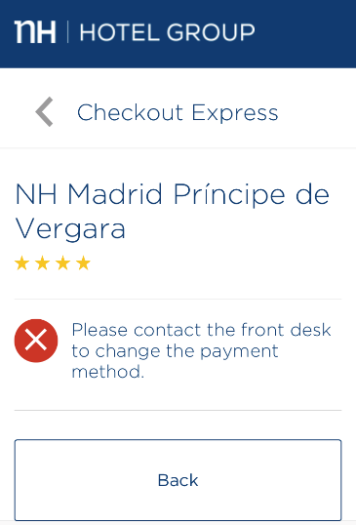

05. User Guide
Back
Data review
Invoice details
Departure time selection
Payment method
Terms & Condicions
The guest will be redirected to Front Desk.
COMPLETED!

Slide 24

05. User Guide
Back
Data review
Invoice details
Departure time selection
Payment method
Once everything is reviewed and ok, the guest will have to read & accept the terms and conditions before completing the check-out.
Terms & Condicions
COMPLETED!

Slide 25
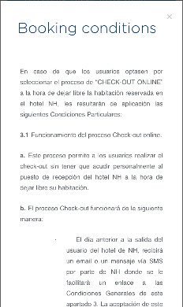

05. User Guide
Back
Data review
Invoice details
Departure time selection
By accepting the OCO terms and conditions, whether he read them or not, the guest is giving us his consent to make the charges according to the billing details and payment method shown to him before.
Payment method
Terms & Condicions
COMPLETED!

Slide 26
05. User Guide
Back
Data review
Invoice details
Departure time selection
1
To finish the process the guest just have to click on Complete check-out
Payment method
2
Terms & Condicions
If for some reason the guest decides not to check-out online, or he does not want to complete the process right now, he can click Cancel and continue with the process later on.
COMPLETED!

Slide 27
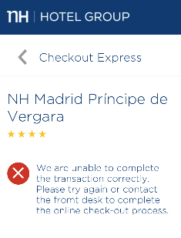

05. User Guide
Back
Data review
Invoice details
Departure time selection
Payment method
Terms & Condicions
The transaction will not be finished.
The guest can try again later or contact Front Desk.
COMPLETED!

Slide 28
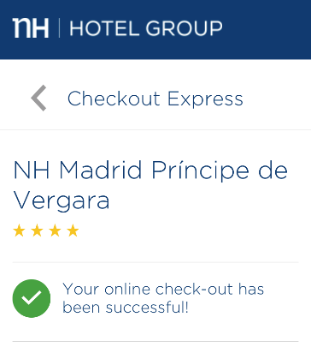
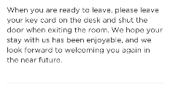
05. User Guide
Back
Data review
Invoice details
Departure time selection
The process is finished now!
The guest will receive some instructions for his departure.
Leave the key inside your room
Your invoice will be sent by email
Payment method
Terms & Condicions
COMPLETED!

Slide 29
05. User Guide
Back
Data review
THANKS!
Invoice details
Departure time selection
Payment method
Terms & Condicions
COMPLETED!

Slide 30




06. Onsite Communication
Here are some examples of how to introduce and explain the Online Check-out to the guests
  Do you know about our brand new service?
  From now on, you will be able to do your check-out using ONLY your mobile/tablet or laptop
Explain the benefits of this service:
“You can save a lot of time for yourself”
“You will have a bill on hand (mobile/e-mail)”
“You can avoid queues on peak time”
“You can do the check-out from anywhere”
“You will be much more eco-friendly”

Slide 31

06. Onsite Communication
Pre-authorization
Pre-authorization is not a very common practice in some countries, this is why sometimes it can be difficult to understand it by our guests. Here you will find some tips to explain it:
When using a DEBIT CARD:
  Pre-authorization amount will be charged on guest´s debit card.
When using a CREDIT CARD:
  We (NH) do not make any changes on the guest´s credit card
  It is guest´s bank who will freeze a certain amount as a warranty
In both cases, when the final invoice amount is lower than pre-authorization amount, this will be cancelled immediately when the payment is made. Each bank has a different term to unfreeze/return the remaining amount of the pre-authorization.

